Slide 1
The Cold War
1945-1960
Chapter 14

Slide 2
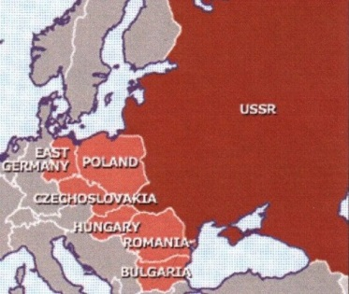
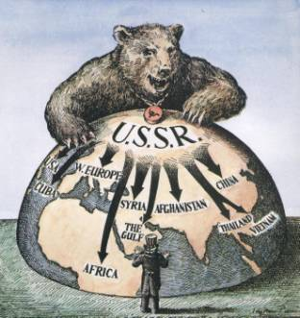

Roots of the Cold War
By the end of World War II, the United States and other Capitalist countries distrusted Communist Soviet Union

Slide 3
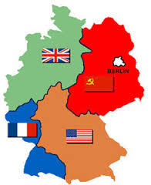
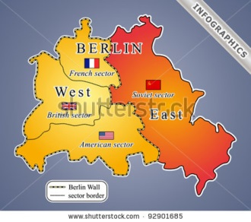
Roots of the Cold War
Stalin put communist friendly governments into power in Eastern Germany, which the United States took as a sign that he wanted to spread communism
The tension that followed became known as the Cold War and lasted almost four decades

Slide 4
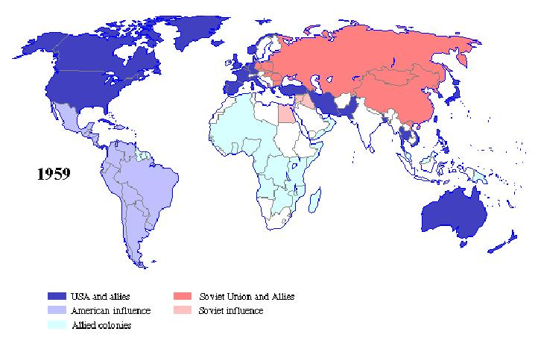
Containment
President Truman decided that containing the threat of communism was the best way to handle it - containment
The Truman Doctrine also promised help for any country resisting communism

Slide 5
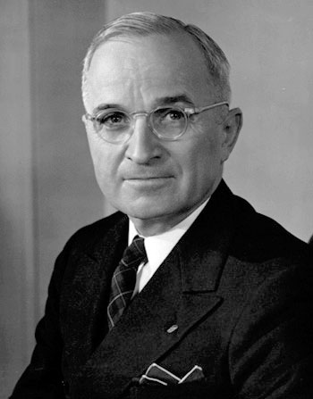
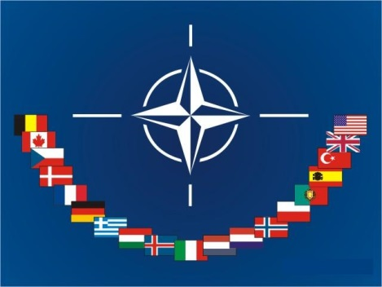
Containment
NATO (the North Atlantic Treaty Organization) was an alliance formed between the U.S., Canada, and Western Europe

Slide 6

Marshall Plan
In response to NATO, the communist powers formed an alliance called the Warsaw Pact
The Marshall Plan offered $13 billion to help nations in Europe rebuild after WWII and resist the spread of communism.

Slide 7
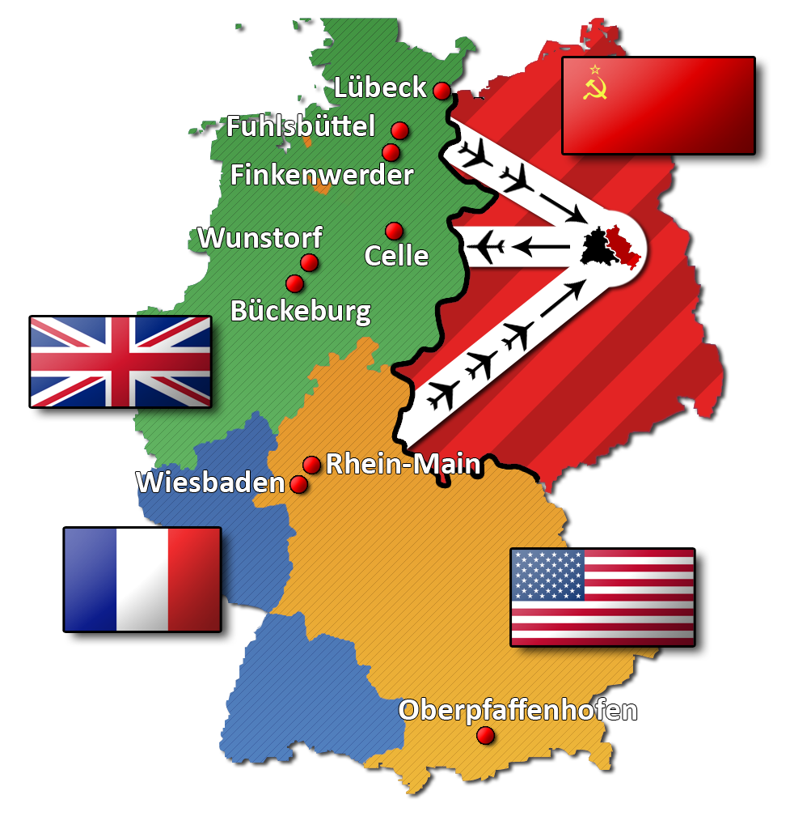
Marshall Plan
The Soviet Union had blocked all access to Berlin, the German capital which required the U.S. and British planes to airlift supplies to stranded Germans

Slide 8
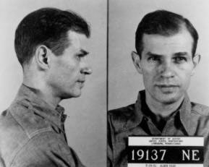
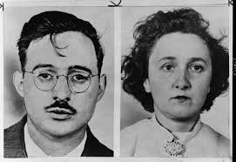
Fear of Communism
The American Communist Party became a target when the country began to fear local communists spying for Russia
The trials of Alger Hiss (5 years in prison) and Julius and Ethel Rosenberg (executed) fueled American fears of communist activity

Slide 9
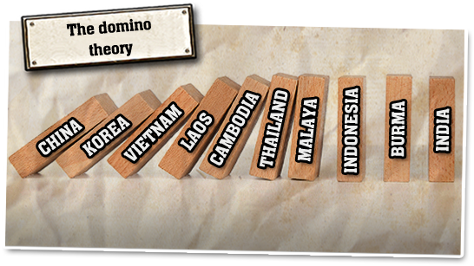
Domino Theory
The U.S. felt that countries would fall to communism like dominoes falling down (known as the Domino Theory)

Slide 10
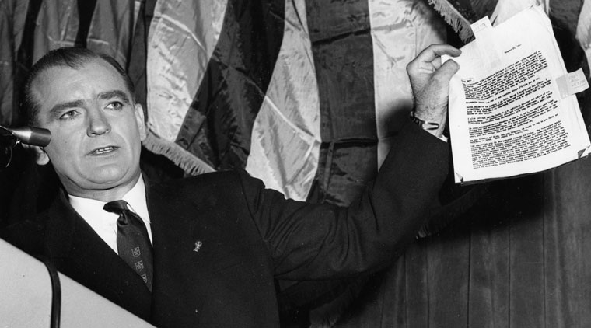
McCarthyism
Senator McCarthy said he had a list of 205 government officials that were communist
McCarthy raised American fears of communism with this “list” even though it was never proven

Slide 11
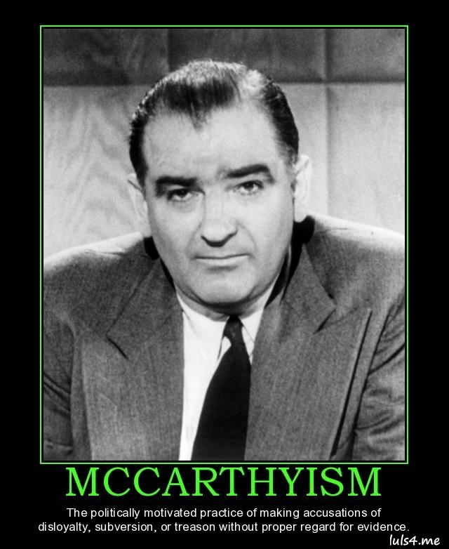
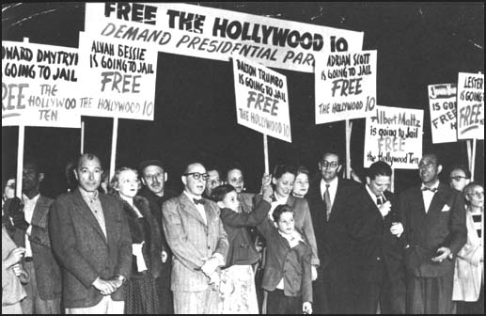
McCarthyism
A manhunt for Communists in the U.S. gov't and blacklisting of Hollywood stars began
The term McCarthyism became a synonym for reckless accusations against innocent people

Slide 12
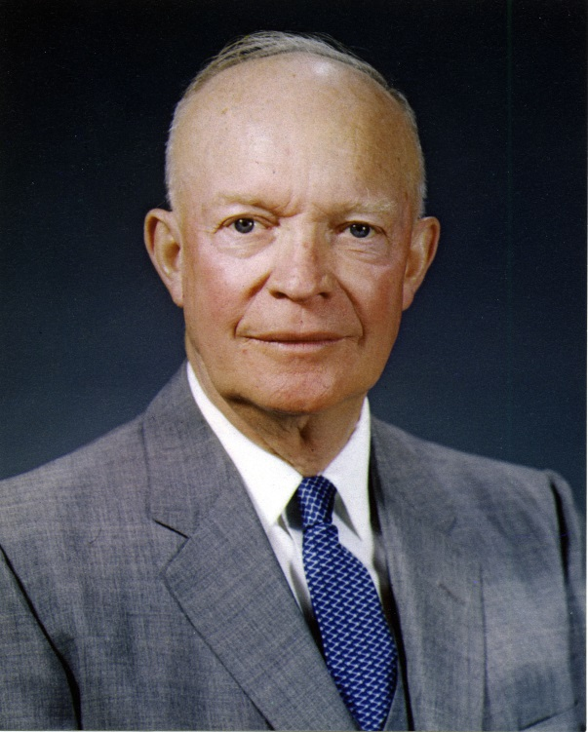
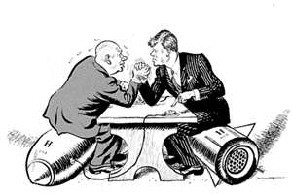
Eisenhower Get Aggressive
Eisenhower wanted to be more aggressive than Truman and his containment policy, he wanted to use a brinksmanship strategy
  Brinksmanship – pushing an issue to the brink of war in order to deal with it

Slide 13
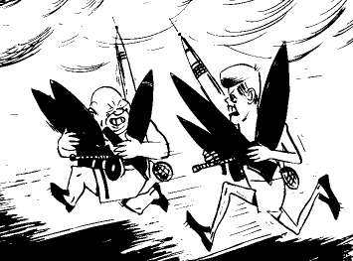
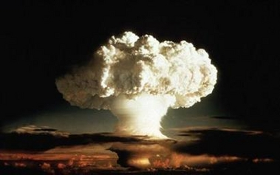
Eisenhower Get Aggressive
The Soviet Union and the U.S. began to build bigger, more powerful weapons to stay ahead of the enemy – Arms Race
  Hydrogen bomb developed (nuclear H-bomb)

Slide 14
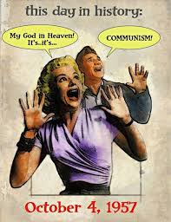
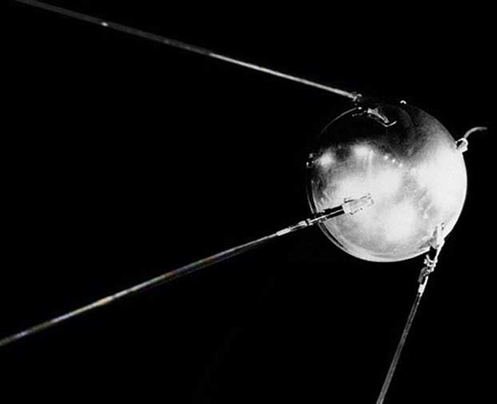
Space Race
Missiles were important in getting the H-bombs across the ocean
The Soviet Union launched the first satellite into space proving they had the missile power

