Slide 1
Chapter one
The Scientific Method

Slide 2
Section 1: What is Science?
Learning About the World
Science:
  a way of learning more about the natural world.
  questions about art, politics, personal preference, and morality cannot be answered by science.
  science can answer a question only with the information available at the time.
  an attempt to explain a pattern observed repeatedly in the natural world is called a scientific theory.

Slide 3
Section 1: What is Science?
Learning About the World
Theories in science must be supported by observations and results from many investigations.
Scientific Law:
  a rule that describes a pattern in nature.
  for an observation to become a scientific law, it must be observed repeatedly.
  A law, unlike a theory, does not attempt to explain why something happens. It simply describes a pattern.

Slide 4
Section 1: What is Science?
Systems in Science
A system is a collection of structures, cycles, and processes that relate to and interact with each other.
  Examples: digestive system, solar system, your school.

Slide 5
Section 1: What is Science?
The Branches of Science
Science often is divided into three main categories, or branches – life science, Earth science, and physical science.
Life Science:
  The study of living systems and the ways in which they interact.

Slide 6
Section 1: What is Science?
The Branches of Science
Earth Science:
  study of Earth systems and the systems in space.
  study of nonliving things such as rocks, soil, clouds, rivers, oceans, planets, stars, meteors, and black holes.

Slide 7
Section 1: What is Science?
The Branches of Science
Physical Science:
  study of matter and energy.
  can be divided into two general fields –chemistry and physics.
    Chemistry is the study of matter and the interactions of matter.
    Physics is the study of energy and its ability to change matter.

Slide 8
Section 1: What is Science?
The Branches of Science
Technology is the practical use of science, or applied science.
  For example: the study of how to use energy of sunlight is science. Using this knowledge to create solar panels is technology.

Slide 9
Section 2: Science in Action
Science Skills
A hypothesis is a reasonable and educated possible answer based on what you know and what you observe.

Slide 10
Section 2: Science in Action
Drawing Conclusions
To infer something means to draw a conclusion based on what you observe.

Slide 11
Section 2: Science in Action
Experiments
A controlled experiment involves changing one factor and observing its effect on another while keeping all other factors constant.
Variables are factors that can be changed in an experiment.

Slide 12
Section 2: Science in Action
Experiments
The variable that is changed in an experiment is called the independent variable.
The dependent variable changes as a result of a change in the independent variable.
The variables that are not change in an experiment are called constants.

Slide 13
Section 3: Models in Science
Why are models necessary?
In science, a model is any representation of an object or an event used as a tool for understanding the natural world.
Models can help you visualize something that is difficult to see or understand.

Slide 14
Section 3: Models in Science
Types of models
Most models fall into three basic types –physical models, computer models, and idea models.
Physical Models: models you can see and touch.
  Examples include: a table top solar system, a globe of the Earth, or a replica of the inside of a cell.

Slide 15
Section 3: Models in Science
Types of models
Computer Models: are built using computer software.
  Example: a computer can model the movement of large plates in the Earth and might help predict earthquakes.
Idea Models: are ideas or concepts that describe how someone thinks about something in the natural world.
  For example: E=mc2

Slide 16
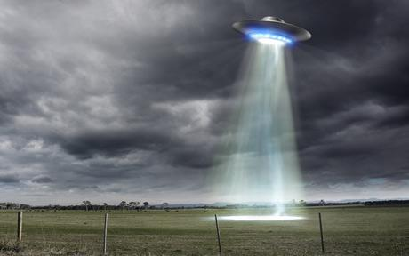
Do you believe what you see?

Slide 17
Section 4: Evaluating Scientific Explanations
Believe it or not?
Critical Thinking means combining what you already know with the new facts that you are given to decide if you should agree with something.

Slide 18
Section 4: Evaluating Scientific Explanations
Evaluating the Data
A scientific investigation always contains observations often called data.
Data is gathered during a scientific investigation and can be recorded in the form of descriptions, tables, graphs, or drawings.

Slide 19
Section 4: Evaluating Scientific Explanations
Evaluating the Conclusions
When you think about a conclusion that someone has made, you can ask yourself two questions…
  First, does the conclusion make sense?
  Second, are there any other possible explanations?

