Slide 1
Chapter Eleven
Earthquakes

Slide 2
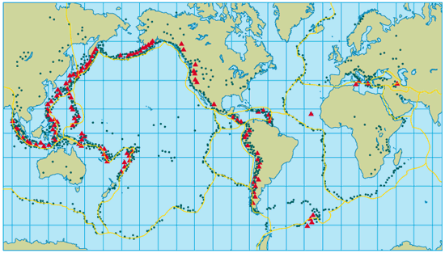
Notes:
2

Slide 3
Section 1: Forces Inside Earth
Earthquake Causes
Fault Formation
  There is a limit to how far rocks can bend or move without cracking.
  Up to a point, applied forces cause rocks to bend and stretch, undergoing what is called elastic deformation.

Slide 4
Section 1: Forces Inside Earth
Earthquake Causes
Fault Formation
  Once the elastic limit is passed, the rock breaks and move along surfaces called faults.
  Rock along one side of a fault can move up, down or sideways in relation to rocks along the other side of the fault.

Slide 5
Section 1: Forces Inside Earth
Earthquake Causes
What Causes Faults?
  As plates move, they cause stress on the rocks near the plate edges. To relieve stress, rocks bend, compress or stretch. If the pressure gets too great the rock will break.
  An earthquake is the vibrations produced by the breaking of rock.

Slide 6
Section 1: Forces Inside Earth
Earthquake Causes
How Earthquakes Occur...
  As rocks move past each other along a fault, their rough surfaces catch, temporarily halting movement along the fault.
  Forces keep driving the faults to move and this action builds up stress at the points where the rocks are stuck.
  When the rocks are stressed beyond their elastic limit they break, move along the fault, and return to original shape = EARTHQUAKE!!!

Slide 7
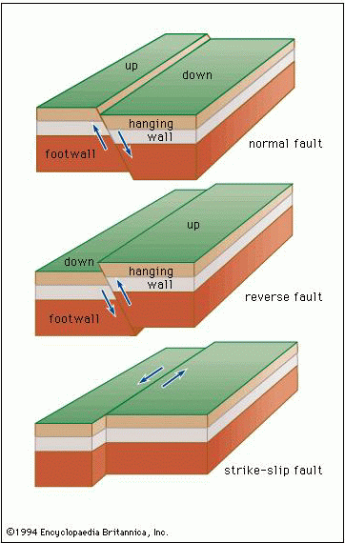
Section 1: Forces Inside Earth
Types of Faults
Normal Faults
  Rock above the fault surface moves downward in relation to rock below the fault surface.
  Caused by tension forces
  Divergent boundary

Slide 8
Section 1: Forces Inside Earth
Types of Faults
Reverse Faults
  Rock above the fault surface is forced up and over the rock below.
  Caused by compression
  Convergent boundary

Slide 9
Section 1: Forces Inside Earth
Types of Faults
Strike-Slip Faults
  Rocks on either side of the fault are moving past each other without upward or downward movement.
  Caused by shearing
  Transform boundary
  Ex. = San Andreas Fault in California

Slide 10
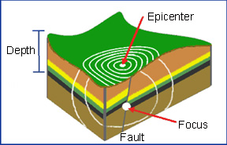
Section 2: Features of Earthquakes
Seismic Waves
Seismic Waves
  As stress is put on rocks until they break, energy is released in the form of seismic waves: waves generated by an Earthquake.
  The point where this energy release first occurs is called the focus of an earthquake.
  They are produced and travel outward from the focus.

Slide 11
Section 2: Features of Earthquakes
Seismic Waves
Primary waves (P-waves)
  Cause particles in rocks to move back and forth in the same direction that the wave is traveling
  Travel the fastest
Secondary waves (S-waves)
  Move through Earth by causing particles in rocks to move at right angles to the direction of wave travel.

Slide 12
Section 2: Features of Earthquakes
Seismic Waves
Surface waves
  Move rock particles in a backward, rolling motion and a side-to-side, swaying motion.
  Produced when earthquake energy reaches the surface.
  Travel outward from the epicenter: the point on earth's surface directly above the earthquake's focus.
  Travel the slowest and cause the most destruction

Slide 13
Section 2: Features of Earthquakes
Locating an Epicenter
Seismograph
  An instrument where seismic waves from earthquakes are measured
  Consist of a rotating drum of paper and a pendulum with an attached pen
  Register the waves and record the time that each arrived

Slide 14
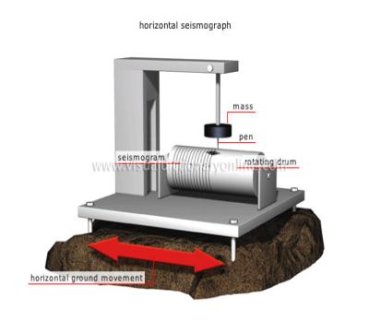
Section 2: Features of Earthquakes
Locating an Epicenter
Seismograph
  When seismic waves reach the seismograph, the drum vibrates but the pendulum remains at rest
  The paper record of the seismic event is called a seismogram

Slide 15
Section 3: People and Earthquakes
Earthquake Activity
The height of the lines traced on the paper of a seismograph is a measure of the energy that is released: magnitude.
Richter magnitude scale
  Used to describe the strength of an earthquake and is based on the height of the lines on the seismogram.
  Has no upper limit
  Scientists think that a 9.5 would be the maximum strength an earthquake could register.

Slide 16
Section 3: People and Earthquakes
Earthquake Activity
Mercalli intensity scale
  Describes the intensity of an earthquake using the amount of structural and geologic damage in a specific location.
  Depends on the strength of an earthquake, the design of the structures and the distance from the epicenter.

Slide 17
Section 3: People and Earthquakes
Results of Earthquakes
Liquefaction
  Occurs when wet soil acts more like a liquid during an earthquake.
  Buildings on this soil can sink into the soil and collapse.

Slide 18
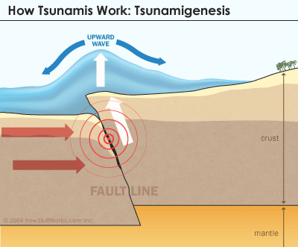
Section 3: People and Earthquakes
Results of Earthquakes
Tsunamis
  Ocean waves caused by earthquakes.
  Occurs when earthquakes under the ocean causes shifts in the ocean floor.
  Can reach 30 meters high

Slide 19
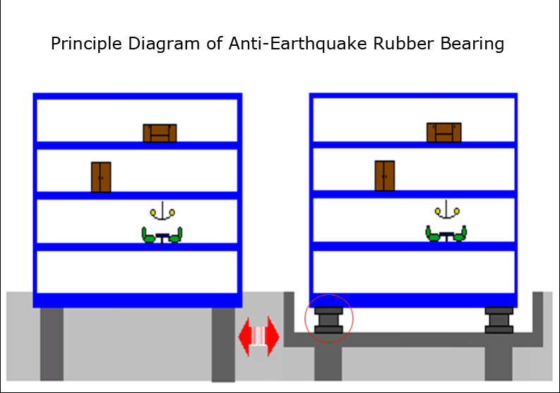
Section 3: People and Earthquakes
Earthquake Safety
Quake-resistant structures
  Buildings and highways that can stand up to vibrations during earthquakes.
    Supported with flexible columns made of steel and rubber
    Install steel rods to enforce walls in older buildings.

Slide 20
Create an Earthquake-Proof City Block
(50 points)
Each group of 3 will be given the following supplies:
  10 pieces of computer paper
  A “desks length” of masking tape
  Scissors
  A large piece of butcher paper
  A large whiteboard
  Markers/colored pencils
  Ruler
Your whiteboard represents a city block. You need to build the following 3D buildings on your city block:
  A high-rise at least 10 inches tall
  A shorter building at least 6 inches long
  4 smaller buildings
  A circular arena
  A bridge that’s elevated above the whiteboard
These buildings cannot be directly connected to the whiteboard.
Your city block must be able to withstand an average Earthquake.
Include a 2 paragraph write-up about the strategies that you used to create an Earthquake-Proof city block.

