Slide 1
Chapter Two
Measurements

Slide 2
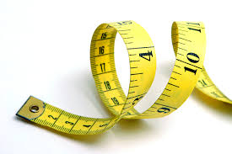
Section 1: Description and Measurement
Measurement
Measurement is a way to describe the world with numbers. It answers questions such as how much, how long, or how far.

Slide 3
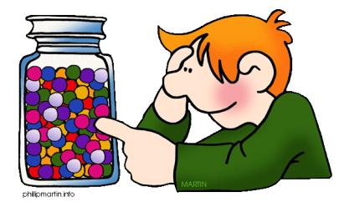
Section 1: Description and Measurement
Estimation
Estimation can help you make a rough measurement on an object. When you estimate, you can use your knowledge of the size of something familiar to estimate the size of a new object.

Slide 4
Section 1: Description and Measurement
Precision and Accuracy
One way to evaluate measurements is to determine whether they are precise.
Precision is a description of how close measurements are to each other.
The term precision also is used when discussing the number of decimal places a measuring device can measure.

Slide 5
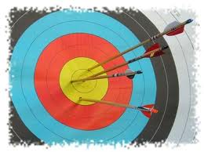
Section 1: Description and Measurement
Precision and Accuracy
When you compare a measurement to the real, actual, or accepted value, you are describing accuracy.
The number of digits that truly reflect the precision of a number are called the significant digits or significant figures.

Slide 6
Section 2: SI Units
The International System
To avoid confusion, scientists established the International System of Units, or SI.
  It was designed to provide a worldwide standard of physical measurement for science, industry, and commerce.
The SI units are related by multiple of ten. Any SI unit can be converted to a smaller or larger SI unit by multiplying by a power of 10.

Slide 7
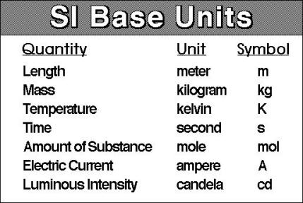
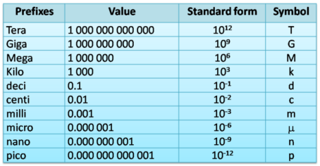
Section 2: SI Units
The International System

Slide 8
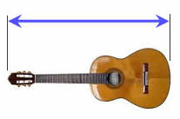
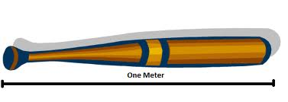
Section 2: SI Units
Length
Length is defined as the distance between two points.
The meter is the SI unit of length.

Slide 9
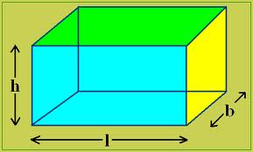
Section 2: SI Units
Volume
The amount of space an object occupies is its volume. Units of volume are created by multiplying units of length.
To find the volume of a square or rectangular object measure its length, width, and height and multiply them together.

Slide 10
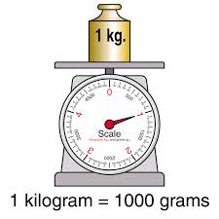
Section 2: SI Units
Mass
The mass of an object measures the amount of matter in the object.
The kilogram (kg) is the SI unit for mass.

Slide 11
Section 2: SI Units
Mass
Weight and mass are not the same. Mass depends only on the amount of matter in an object.
Weight is a measurement of force. The SI Unit for weight is the newton (N).
Weight depends on gravity, which can change depending on where the object is located.

Slide 12
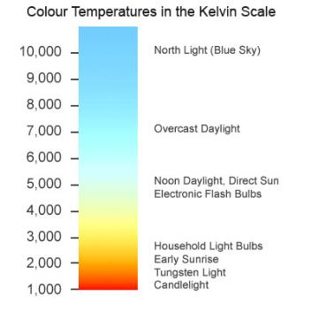
Section 2: SI Units
Temperature
The physical property of temperature is related to how hot or cold an object is.
Temperature is a measure of the kinetic energy, or energy of motion, of the particles that make up matter.
Temperature is measure in SI with the Kelvin (K).

Slide 13
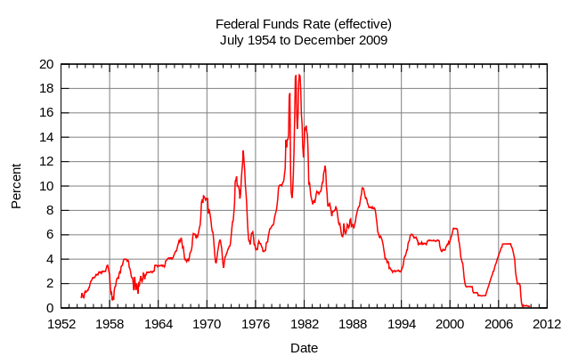
Section 2: SI Units
Time and Rates
Time is the interval between two events.
The SI unit of time is the seconds (s). Time also is measured in hours (h).
A rate is the amount of change of one measurement in a given amount of time.

Slide 14
Section 3: Drawings, Tables, and Graphs
Scientific Illustrations
A drawing:
  sometimes the best choice to show detail
  can emphasize only the things that are necessary to show
  can show hidden things that you cannot see
A still photograph shows an object exactly as it is at a single moment in time.

Slide 15
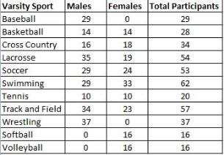
Section 3: Drawings, Tables, and Graphs
Tables and Graphs
Everyone who deals with numbers and compares measurements need an organized way to collect and display data.
A table displays information in rows and columns so that it is easier to read and understand.

Slide 16
Section 3: Drawings, Tables, and Graphs
Tables and Graphs
A graph is used to collect, organize, and summarize data in a visual way.
Three commons types of graphs are line, bar, and circle graphs.

Slide 17
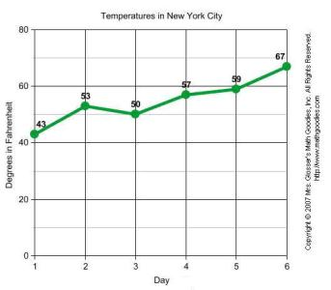
Section 3: Drawings, Tables, and Graphs
Tables and Graphs
A line graph shows the relationship between two variables. A variable is something that can change, or vary. Both variables in a line graph must be numbers.

Slide 18
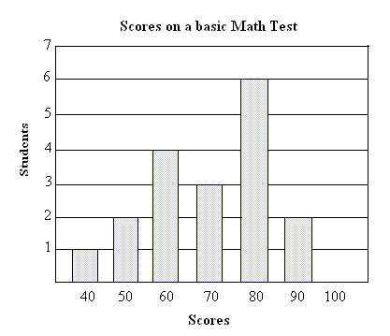
Section 3: Drawings, Tables, and Graphs
Tables and Graphs
A bar graph uses rectangular blocks, or bars, of varying sizes to show the relationship among variables. One variable must be divided into parts, such as the time of day or category. The other variable must be a number.

Slide 19
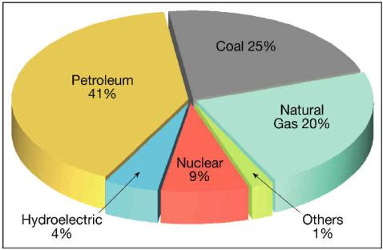
Section 3: Drawings, Tables, and Graphs
Tables and Graphs
A circle graph, or “pie graphs” shows the part of a whole. Each piece of the pie visually represents a fraction of the total.

