Slide 1

Confederation to Constitution
1776-1791
Chapter 2

Slide 2

In this unit we will…
Look at some of the ideas and documents that influenced the writing of the Constitution.
Explore the reasons for and outcome of the Constitutional Convention.
Analyze the arguments between the federalists and anti-federalists over the Constitution.
Describe the significance of key documents, events, and people involved in the Constitutional era.
Get an overview of the Constitution and the changes that have been made to it.

Slide 3
Documents and Ideas That Helped Shape The Constitution
Magna Carta
English Bill of Rights
Montesquieu's separation of powers
John Locke's theories on natural law and social contract
Mayflower Compact
Declaration of Independence
Articles of Confederation

Slide 4
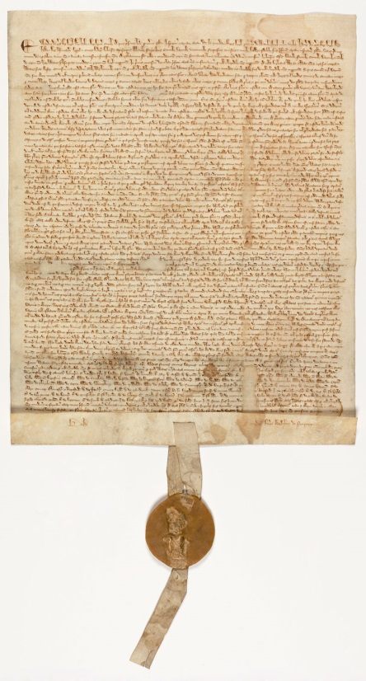
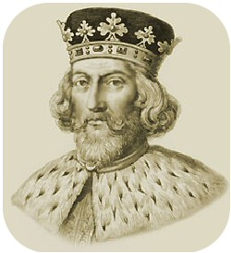
Magna Carta
Magna Carta = Great Charter
  King John of England agreed to the Magna Carta being written in 1215
  Gave all freemen in England the rights and liberties described in the charter and required all men, even the King, to obey its laws
  Was the basis for England's system of law and was copied by American colonists
  Allowed citizens to elect representatives to government

Slide 5

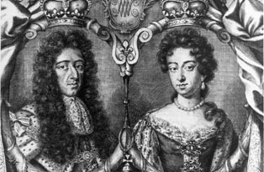
English Bill of Rights
English Bill of Rights
  Document written in 1689, gave Englishmen rights that the King could not take away.
  Made it illegal for the King to create his own court system or become a judge.
  Described the line of successors for the next Queen or King.
William and Mary

Slide 6
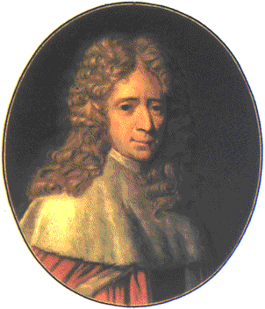
Montesquieu’s Separation of Powers
Montesquieu's Separation of Powers
  Montesquieu wrote a book, On the Spirit of Laws, that described how a government would work best, basing his ideas on England's government.
  He thought that democracy was the best form of government.
    Democracy = a government in which the people have the power
  He also thought for a democracy to be successful the power must be divided into three branches
    Law makers, law enforcers, and law interpreters

Slide 7
Montesquieu’s Separation of Powers
Montesquieu's Separation of Powers
  He felt it was important to give these three branches equal but different powers.
  By keeping powers equal and separate, the branches of government would keep each other in check.
  He’s separation of powers became the basis for the Constitution and government.

Slide 8
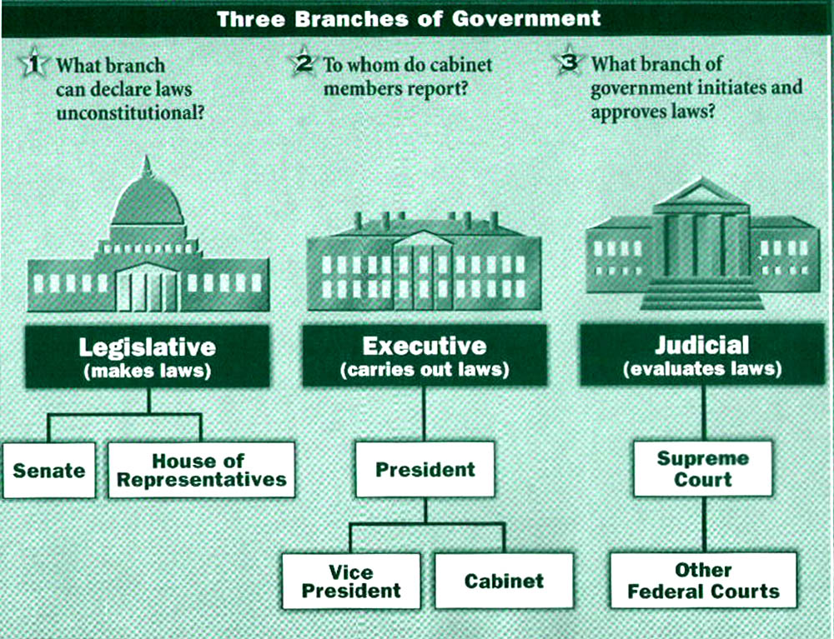

Slide 9
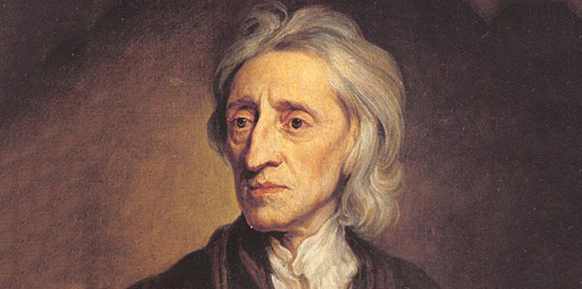
John Locke’s Natural Law and Social Contract
John Locke’s Natural Law and Social Contract
  His idea of natural law is that everyone is born with natural rights that governments cannot take away.
  His idea of a social contract was really an agreement between the government and the people it governed.
  A social contract is when you give up some of your personal rights and let a higher authority rule you for the good of the community.

Slide 10
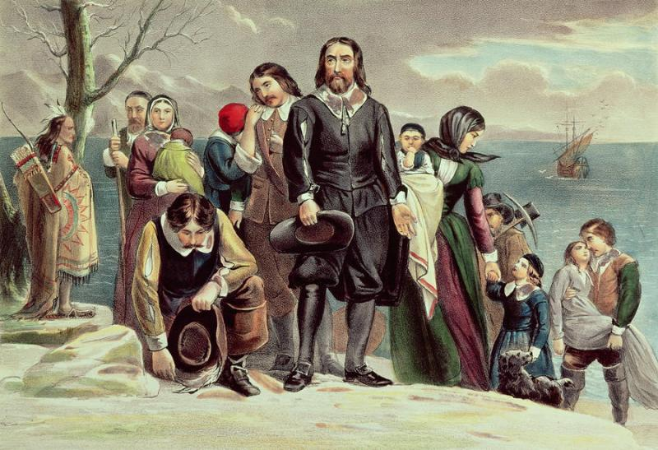
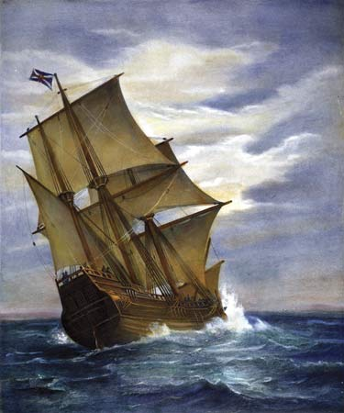
Mayflower Compact
Mayflower Compact
  A document signed in 1620 by the settlers sailing on the Mayflower.
  A list of rules that would govern their new settlement.
  41 men on the ship signed the Mayflower Compact agreeing to follow these rules for the good of the community.
  This was one of the first examples of self-government (where you decide your own rules and agree to follow them).

Slide 11
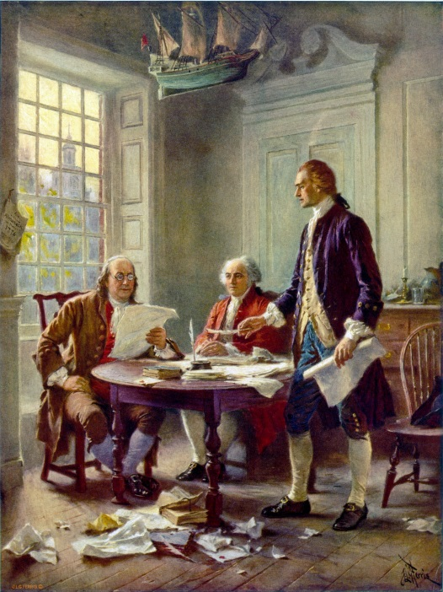
The Declaration of Independence
The Declaration of Independence
  Designed by a committee of five men and written by Thomas Jefferson
  This document had three major parts:
    Preamble (declaring our natural rights)
    Grievances against the King (why they were upset)
    Declaration of independence from England (saying they were free and independent from that point on)
  One of the most important documents we have in this country.

Slide 12
Articles of Confederation
The Articles of Confederation
  A document that united the original 13 states and set up a committee of representatives from each state called Congress to protect the new country.
  Gave Congress the power to conduct foreign affairs, declare war, and create an army and navy (basically keep the states safe).
  Were written in 1777, during the Revolutionary War, but did not take effect until 1781 when the last state signed the document.
  Basically the first version of the Constitution of the United States.

Slide 13
Articles of Confederation
Problems with the Articles of Confederation
  The Founding Fathers were afraid to give a central government too much power (like a King).
  The Articles did not allow Congress to collect taxes, make laws that states have to follow, or enforce laws (basically Congress couldn't make any decisions that affected the states).
  They gave the individual states the majority of the power, leaving the central government powerless to solve internal problems.
  A stronger central government was needed so they agreed to write the Constitution in 1787.

Slide 14
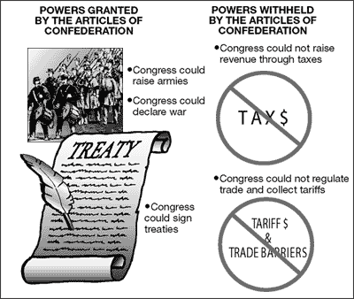
Strengths vs. Weaknesses

Slide 15
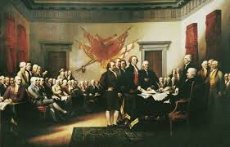
Constitutional Convention
Constitutional Convention
  Since the Articles of Confederation were not very effective, each state sent delegates (or representatives) to a meeting in Philadelphia in May of 1787
  The meeting became known as the Constitutional Convention and the delegates decided to write a new document, borrowing ideas from other documents, that would serve as a basis for a new government in the United States of America
  Many ideas were presented but two ideas were focused on heavily as possible solutions on how to form the government

Slide 16
Compromises
The Great Compromise
  Virginia Plan – Representation by population
  New Jersey Plan – Each state has two Representatives
    To make both small states and large states happy, two houses were created in Congress
      House of Representatives (population)
      Senate (equal representation)
  Not everyone agreed, on how slaves should be counted for population and tax purposes
  Again, a compromise was reached where each slave would be counted as 3/5 of a person, or three out of every five slaves counted – 3/5 Compromise

Slide 17
Federalists vs. Anti-Federalists
Federalists
  Were people who supported the ratification (or approval) of the Constitution and wanted a strong central government
    This group wrote articles for the newspaper called The Federalist Papers to gain support for the Constitution
Anti-Federalists
  Were people who opposed the ratification of the Constitution without serious changes to it
  They were afraid the central gov't would take away personal rights and state's powers – they wanted a Bill of Rights to guarantee personal rights
Both sides agreed to add a Bill of Rights after ratification as a compromise

Slide 18
The Constitution
The Constitution has seven principles and seven articles (or basic ideas) that helped build the foundation of the country's new government.
  1 – Popular Sovereignty (government where the people rule)
  2 – Republicanism (people vote for their representatives)
  3 – Federalism (government where power is divided between the central government and state governments)
  4 – Separation of Powers (Judicial, Legislative, and Executive branches share the power so nobody has too much power)
  5 – Checks and Balances (each branch checks on the others to keep them in line and balance the power)
  6 – Limited Government (everyone has to follow the laws)
  7 – Individual Rights (personal rights are guaranteed by first ten amendments, called the Bill of Rights)

Slide 19
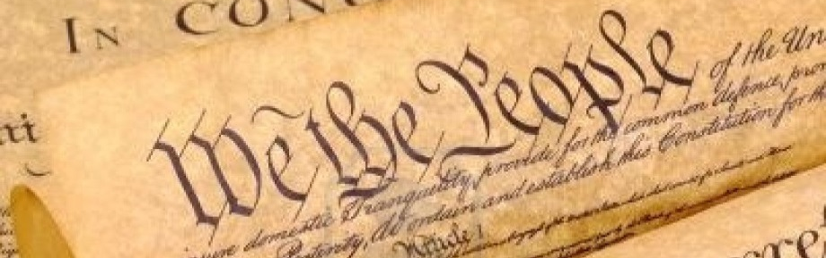
The Constitution: Seven Articles
Preamble – States the purpose of the Constitution
Article I – The Legislature (Congress) makes laws and is made up of two houses:
  House of Representatives (number of reps depends on population of each state)
  Senate (2 senators from each state)
Article II – The Executive (President) enforces laws and includes the Vice President and Cabinet
Article III – The Judiciary (Supreme Court) interprets laws and includes all federal courts

Slide 20
The Constitution: Seven Articles
Article IV – Relations Among States – States must respect each others laws, records, and court rulings
Article V – Amending the Constitution – details the steps in order to amend (or change) the Constitution
Article VI – Supremacy of the National Government – this section states that the Constitution, national laws, and treaties are supreme and must be followed
Article VII – Ratification – nine out of the original thirteen states had to ratify (or approve) the Constitution before it could go into effect

Slide 21
The Bill of Rights
The first ten amendments (Bill of Rights) were all passed immediately after the Constitution was ratified (1791) and guarantee personal freedoms
  1st Amendment – Religious and Political Freedom
  2nd Amendment – Right to Bear Arms
  3rd Amendment – Quartering Troops
  4th Amendment – Search and Seizure
  5th Amendment – Right of Accused Persons
  6th Amendment – Right to a Speedy, Public Trial
  7th Amendment – Trial by Jury in Civil Cases
  8th Amendment – Limits of Fines and Punishments
  9th Amendment – Rights of People
  10th Amendment – Powers of States and People

Slide 22
Amendments 11-27
11th – Lawsuits Against States - 1798
12th – Election of Executives - 1804
13th – Slavery Abolished – 1865
14th – Civil Rights – 1868
15th – Right to Vote (no women) – 1870
16th – Income Tax – 1913
17th – Direct Election of Senators – 1913
18th – Prohibition – 1919
19th – Woman Suffrage – 1920
20th - “Lame Duck” Sessions – 1933
21st – Repeal of Prohibition – 1933
22nd – Limit on Presidential Terms – 1951
23rd – Voting in District of Columbia – 1961
24th – Abolition of Poll Taxes – 1964
25th – Presidential Disability, Succession – 1967
26th – 18-year-old Vote – 1971
27th – Congressional Pay - 1992

