Slide 1
Chapter 20 & 21
Our Impact on Land, Water, and Air

Slide 2
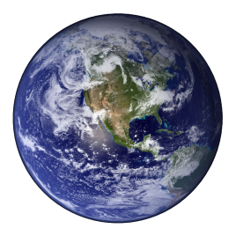
Section 1: Population Impact on the Environment
Population and Carrying Capacity
A population is all of the individuals of one species occupying a particular area.
The global population in 2000 was 6.1 billion. Each day, the number of humans increases by approximately 200,000.

Slide 3
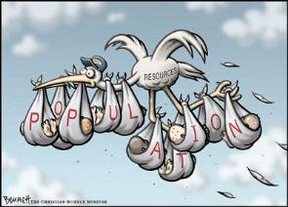
Section 1: Population Impact on the Environment
Population and Carrying Capacity
The human population has increased because modern medicine, clean water, and better nutrition have decreased the death rate.
Carrying capacity is the largest number of individuals of a particular species that the environment can support.

Slide 4
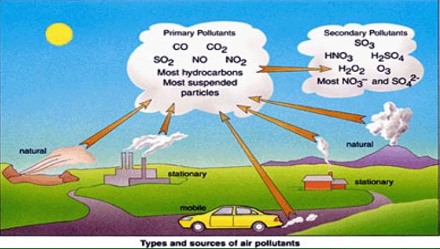
Section 1: Population Impact on the Environment
People and the Environment
Pollutants are a substance that contaminates the environment.
As populations continue to grow, more resources are used and more waste is created.

Slide 5
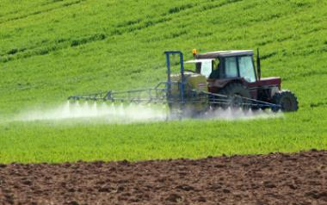
Section 2: Using Land
Land Usage
AGRICULTURE:
About 16 million km of Earth’s total land surface is used as farmland.
  Basic farmer: use higher-yielding seeds and chemical fertilizers, which increases the amount of food grown on each km of land.
  Organic farmer: use natural fertilizers, crop rotation, and biological pest controls, which helps crops grow without using chemicals. However, organic farming cannot currently produce enough food to feed all of Earth’s people.

Slide 6
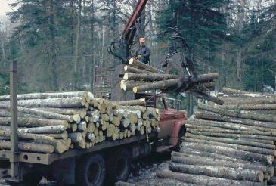
Section 2: Using Land
Land Usage
FOREST:
One-fourth of the land area on Earth is covered by forest.
Deforestation is the clearing of forested land for agriculture, grazing, development, or logging.
Extinction and climate change are two negative effects from deforestation.

Slide 7
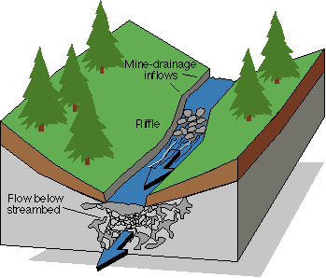
Section 2: Using Land
Land Usage
DEVELOPMENT:
Stream discharge is the volume of water flowing past a point per unit of time.

Slide 8
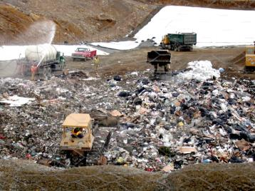
Section 2: Using Land
Land Usage
SANITARY LANDFILLS:
A sanitary landfill is an area where each day’s garbage is deposited and covered with soil.
The soil prevents the deposit from blowing away; helps decompose some materials, and reduces the odor produced by the decaying waste.

Slide 9
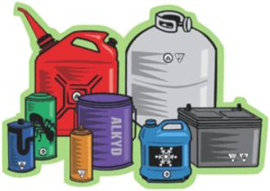
Section 2: Using Land
Hazardous Waste
Wastes that are poisonous, that cause cancer, or that can catch fire are called hazardous waste.
Enzymes are substances that make chemical reactions go faster.
Enzymes from plant roots increase the rate at which organic pollutants are broken down into simpler substances.

Slide 10
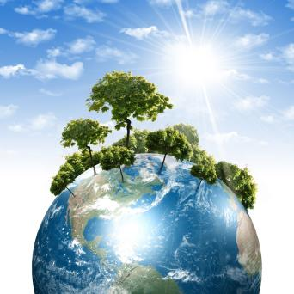
Section 2: Conserving Resources
Resource Use
Conservation is the careful use of earth materials to reduce damage to the environment.

Slide 11
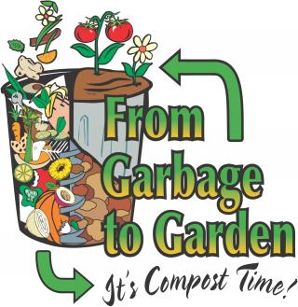
Section 2: Conserving Resources
Reduce, Reuse, Recycle
Ways to conserve resources include reducing the use of materials, and reusing and recycling materials.
Composting means piling yard wastes where they can decompose gradually.

Slide 12
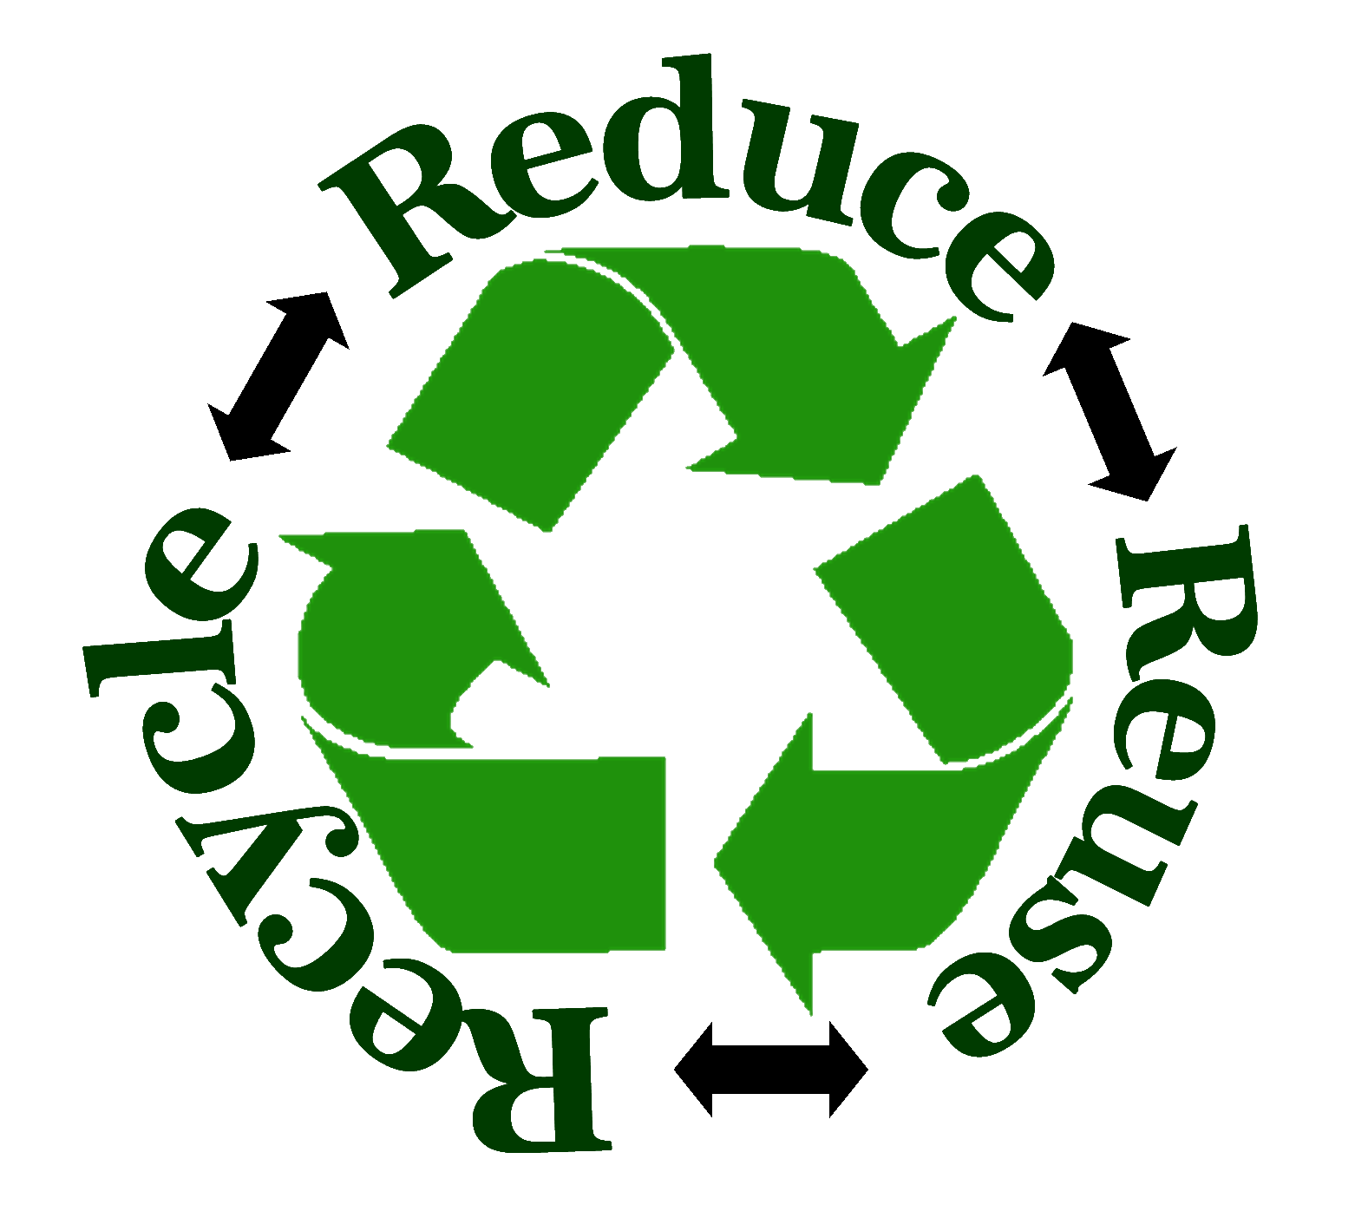
Section 2: Conserving Resources
Reduce, Reuse, Recycle
Decomposed material provides needed nutrients for your garden or flower bed.
Using materials again is called recycling.

Slide 13
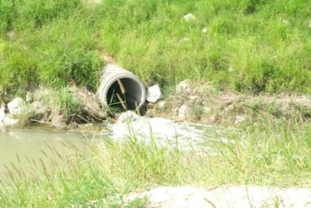
Section 1: Water Pollution
Sources of Water Pollution
Point source pollution is pollution that enters water from a specific location, such as drainpipes or ditches.
Pollution from point sources can be controlled or treated before the water is released to a body of water.

Slide 14
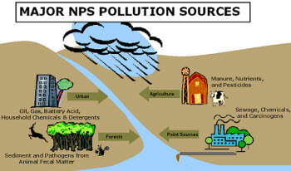
Section 1: Water Pollution
Sources of Water Pollution
Pollution that enters a body of water from a large area, such as lawns, construction sites and roads, is called nonpoint source pollution.
Nonpoint sources also include pollutants in rain or snow.

Slide 15
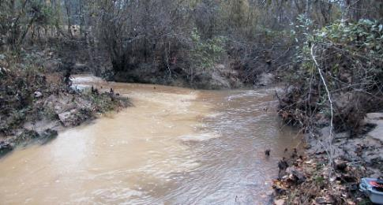
Section 1: Water Pollution
Sources of Water Pollution
The largest source of water pollution in the United States is sediment.
Sediment is loose material, such as rock fragments and mineral grains, that is moved by erosion.

Slide 16
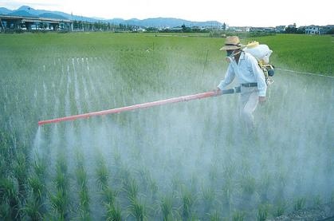
Section 1: Water Pollution
Sources of Water Pollution
Farmers and home owners apply pesticides, which are substances that destroy pests, to keep insects and weed from destroying their crops and lawns.
Fertilizers are chemicals that help plants grow.

Slide 17
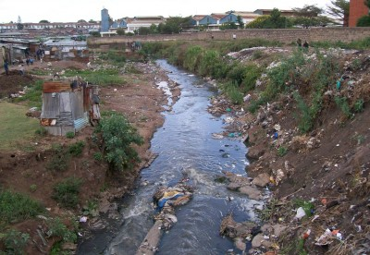
Section 1: Water Pollution
Sources of Water Pollution
When you flush a toilet or take a shower, the water that goes into drains, called sewage, contains human waste, household detergents, and soaps.

Slide 18
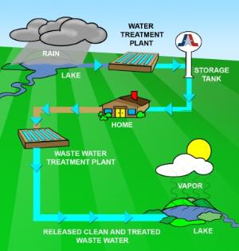
Section 1: Water Pollution
Reducing Water Pollution
One way to reduce water pollution is by treating water before it enters a stream, lake, or river.
Disposing of wastes safely and conserving water are the best ways to decrease water pollution.

Slide 19
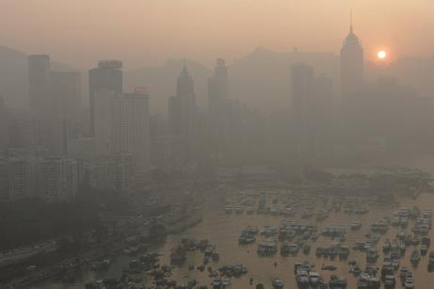
Section 2: Air Pollution
Causes of Air Pollution
The hazy, yellowish brown blanket of smog that is sometimes found over cities is called photochemical smog because it forms with the help of sunlight.

Slide 20
Section 2: Air Pollution
Causes of Air Pollution
When acidic moisture falls to Earth as rain or snow, it is called acid rain. Acid rain can corrode structures, damage forests, and harm organisms.
The amount of acid is measured using the pH scale.
A lower number means greater acidity.
  Acids = substances with a pH lower than 7
  Bases = substances with a pH above 7

Slide 21
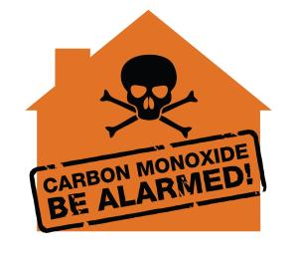
Section 2: Air Pollution
Air Pollution and Your Health
Carbon monoxide, a colorless, odorless gas found in car exhaust, contributes to air pollution and can make people ill, even in small contributions.
Particular matter consists of fine particles such as dust, pollen, mold, ash, and soot that are in the air.

Slide 22
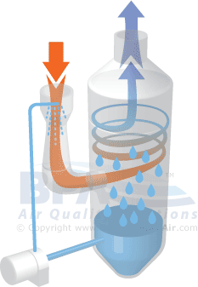
Section 2: Air Pollution
Reducing Air Pollution
Sulfur dioxide can be removed by passing the smoke through a scrubber. A scrubber lets the gases react with limestone and water mixture

