Slide 1
Chapter twenty-two
Exploring Space

Slide 2
Section 1: Radiation from Space
Electromagnetic Waves
The light and other energy leaving a star are forms of radiation.
Radiation:
  Energy that is transmitted from one place to another by electromagnetic waves. These waves carry energy through empty space and through matter.
Electromagnetic spectrum:
  The arrangement of electromagnetic waves according to their wavelengths.

Slide 3
Section 1: Radiation from Space
Electromagnetic Waves
Forms of electromagnetic waves also differ in frequency
Frequency:
  The number of wave crests that pass a given point per unit of time.
  The shorter the wavelength, the higher the frequency.
  Although electromagnetic waves differ in wavelengths, they all travel at 300,000 km/s = the speed of light.

Slide 4
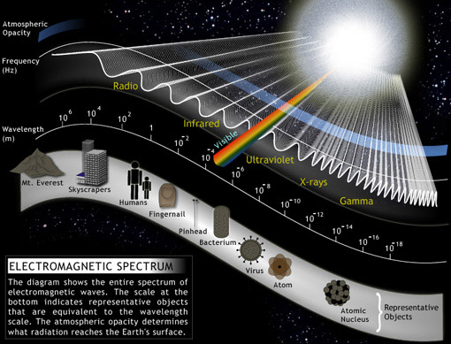

Slide 5
Section 1: Radiation from Space
Optical Telescopes
Optical telescopes use light, which is a form of electromagnetic radiation, to produce magnified images of objects. Light is collected by an objective lens or mirror, which then forms an image at the focal point of the telescope.

Slide 6
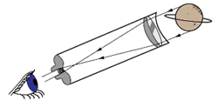
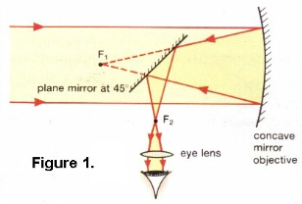
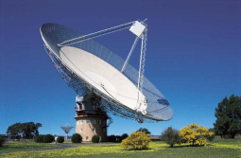
Section 1: Radiation from Space
Optical Telescopes
Refracting telescope: uses convex lenses (curved outward like the surface of a ball)
Reflecting telescope: uses concave lenses (curved inward)
Radio Telescope: used to study radio waves traveling through space.

Slide 7
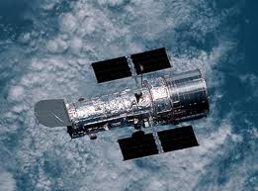
Section 1: Radiation from Space
Optical Telescopes
Most optical telescopes used by professional astronomers are housed in buildings called observatories.
Hubble Space Telescope: launched in 1990 by the space shuttle Discovery, repaired from 1993-1999 (mirrors in telescope were misshapen), has taken pictures of large clusters of galaxies since then.

Slide 8
Section 2: Early Space Missions
The First Missions Into Space
To break free of gravity and Earth's orbit, space-crafts must travel at speeds greater than 11 km/s
Rocket: a special engine that can work in space and burns liquid or solid fuel
Satellite: any object that revolves around another object.

Slide 9
Section 2: Early Space Missions
The First Missions Into Space
When an object enters space, it travels in a straight line unless a force, such as gravity, makes it turn. Earth's gravity pulls a satellite toward Earth.
The result of the satellite traveling forward while at the same time being pulled toward Earth is a curved path called an orbit, around Earth.

Slide 10
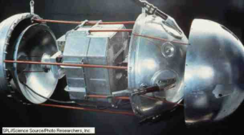
Section 2: Early Space Missions
The First Missions Into Space
Sputnik I, launched by the former Soviet Union in 1957, was the first artificial satellite. Orbited Earth for 57 days before gravity pulled it back into the atmosphere, where it burned up.
  Today thousands of satellites orbit the Earth.
    Communication satellites (transmit radio and TV programs)
    Weather satellites

Slide 11
Section 2: Early Space Missions
Space Probes
Space Probes: instruments that gather information and send it back to Earth.
  Doesn't just orbit the Earth, but goes further into space. Some have traveled to the end of the solar system.

Slide 12
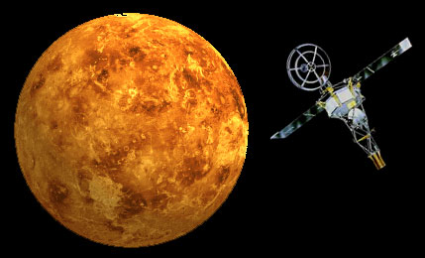
Section 2: Early Space Missions
Space Probes
Mariner 2, launched in 1962, traveled to Venus
Pioneer 10, launched 1972, first probe to encounter an outer planet – Jupiter – as of 2003, it was more than 12 billion km from Earth and will continue to transmit data.

Slide 13
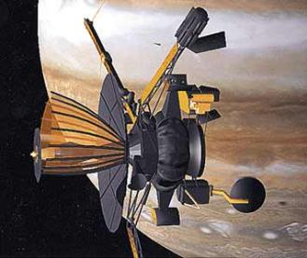
Section 2: Early Space Missions
Space Probes
Voyager 1&2, launched in 1977, traveled past Jupiter, Saturn, Uranus and Neptune and is currently heading toward deep space.
Galileo, launched in 1989, reached Jupiter in 1995 and released a smaller probe to enter Jupiter's atmosphere and continues to study Jupiter's moons.

Slide 14
Section 2: Early Space Missions
Moon Quest
1961, Soviet cosmonaut Yuri A. Gagarin became the first human in space. He orbited Earth and returned safely.
President Kennedy made it a goal to have the US send humans to the moon before 1970.

Slide 15
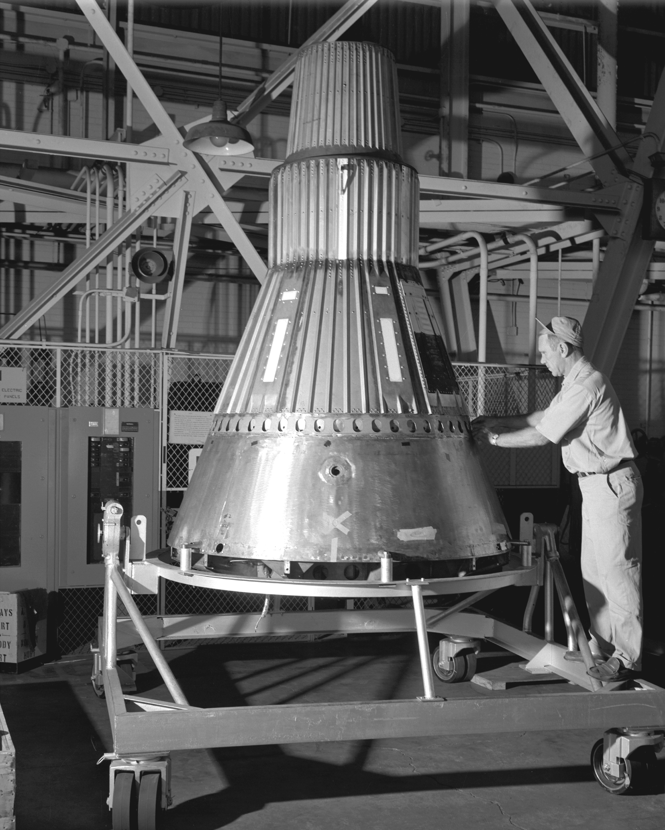
Section 2: Early Space Missions
Moon Quest
Project Mercury: orbit a piloted spacecraft around the Earth and return safely.
  May 5, 1961 – Alan B. Shepard became the first US citizen in space.
  In 1962, Mercury astronaut John Glenn became the first US citizen to orbit Earth.

Slide 16
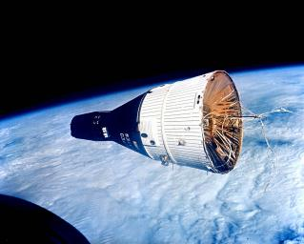
Section 2: Early Space Missions
Moon Quest
Project Gemini: the 2nd step to reach the moon.
  One team met and connected with another space craft in orbit.
  Studied the effects of space travel on the human body.
  Robotic probes sent to the moon to investigate. In 1966, Surveyor landed on the moon, indicating that the Moon's surface could support spacecraft and humans.

Slide 17
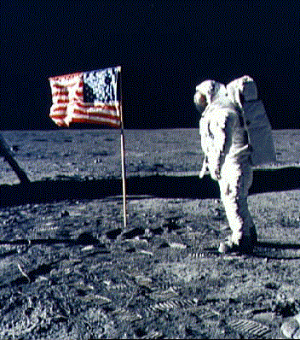
Section 2: Early Space Missions
Moon Quest
Project Apollo: the final stage of the program to reach the moon.
  July 20, 1969: Apollo 11 landed on the Moon's surface.
  Neil Armstrong was the first human to step on the surface of the moon.
  Explored surface of the moon for 2 hours.

Slide 18
Section 3: Current and Future Space Missions
The Space Shuttle
Space Shuttle: a reusable spacecraft that transports astronauts, satellites and other materials to and from space.
  Can study effects of space travel on the human body
  Launch, repair and retrieve satellites

Slide 19
Section 3: Current and Future Space Missions
The Space Shuttle
Space Stations: a large facility with living quarters, work and exercise areas, and equipment and support systems for humans to live and work in space and conduct research.
  In 1995, US and Russia began an era of cooperation and trust in exploring space.
  International Space Station: a laboratory designed for long-term research projects.
  More than 15 nations contributed to construction.

Slide 20
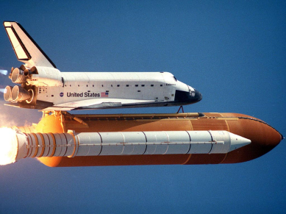
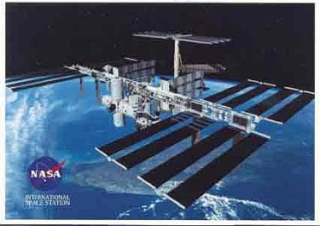
Section 3: Current and Future Space Missions
The Space Shuttle

Slide 21
Section 3: Current and Future Space Missions
Exploring Mars
1996, Mars Global Surveyor and Mars Pathfinder orbited and landed on the surface.
Remote robot rover called Sojourner gathered information and took pictures. It was determined that water recently had seeped to the surface of Mars in some areas.

Slide 22
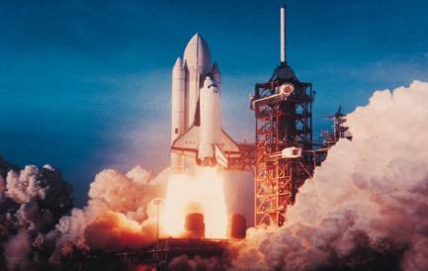
Section 3: Current and Future Space Missions
Exploring Mars
2002, Mars Odyssey began mapping the surface of Mars.
Determined that Martian soil contains frozen water in the southern polar area.

Slide 23
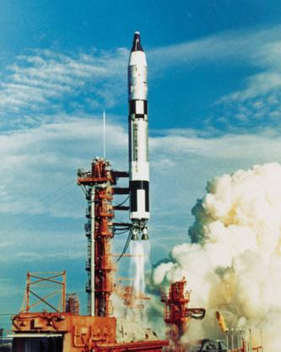
Space Exploration Timeline
Pick 6 important events from the History of Space Exploration.
  These should have the greatest impact on how far we’ve come since the beginning of the Space Race to present day.
For each event, you must include:
  The date (year)
  A detailed explanation of the event
  A picture
Don’t forget a title.

