Slide 1
Chapter 23 &24
The Solar System

Slide 2
Section 1: Earth
Properties of Earth
Earth
  So far as we know today, it is the only planet in our Solar System that can sustain life as we know it.
Early thoughts of Earth:
  Thought the Earth was the center of the universe and the Sun revolved around it.
  Thought Earth was flat.

Slide 3
Section 1: Earth
Properties of Earth
Modern facts:
  Earth is a sphere: a round three dimensional object.
  Aristotle, a Greek philosopher and astronomer, lived around 350 BC, suspected Earth was spherical because he noticed the curved shadow of Earth on the moon.
  Sailors noticed how ships appeared as they came closer, and how the stars appeared and moved at night.

Slide 4
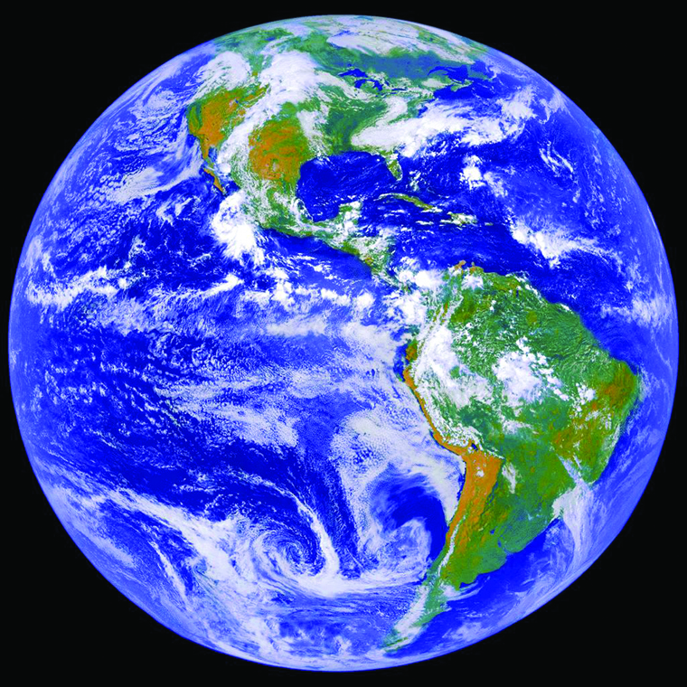
Section 1: Earth
Properties of Earth
Earth rotates on its axis: imaginary vertical line in which Earth spins around.
The spinning on its axis is called the rotation which causes day and night.

Slide 5
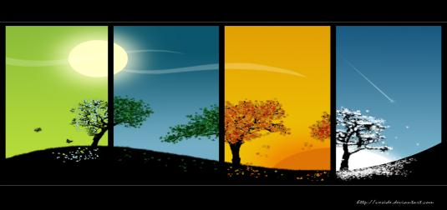
Section 1: Earth
What Causes Seasons?
Revolution is the yearly orbit around the sun and this causes the changes of the seasons.
Earth revolves around the Sun in an ellipse or an elliptical shape which is an elongated, curved shape.

Slide 6
Section 1: Earth
What Causes Seasons?
The distance from the Sun is not always the same throughout the year.
  Closest to the Sun = January 3
  Farthest from the Sun = July 4
Earth’s axis is tilted, which causes parts of the planet to have more or less hours of direct sunlight.
The angle of direct sunlight increases or decreases the amount of radiation.
This all contributes to the seasonal changes.

Slide 7
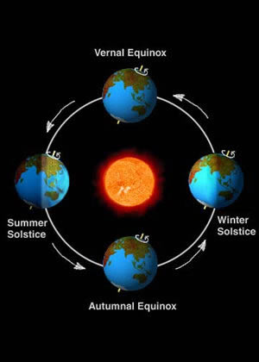
Section 1: Earth
What Causes Seasons?

Slide 8
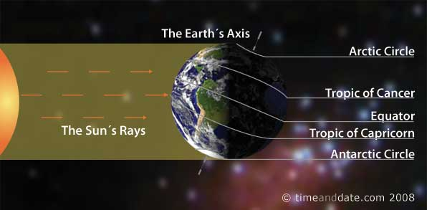
Section 1: Earth
Solstice and Equinox
A solstice is the day when the Sun reaches its greatest distance north or south of the equator
  Summer solstice = June 21 or 22
  Winter solstice = December 21 or 22

Slide 9
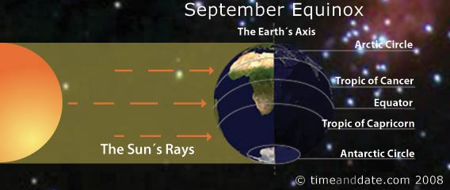
Section 1: Earth
Solstice and Equinox
An equinox occurs when the Sun is directly above Earth’s equator.
During an equinox, the number of daylight and nighttime hours is nearly equal all over the world.

Slide 10
Section 2: The Moon
Motion of the Moon
Relationship of the Moon
  The moon rotates on its axis and revolves around the Earth, just as the Earth relates to the Sun.
  The moon’s rotation = 27.3 days.
  The moon’s revolution = 27.3 days.

Slide 11
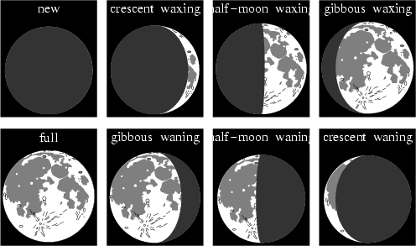
Section 2: The Moon
Phases of the Moon
Moon phases:
  The different forms the moon takes in its appearance from the Earth.
  This depends on the position of the Moon with the Earth and the Sun.

Slide 12
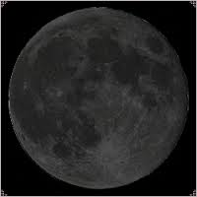
Section 2: The Moon
Phases of the Moon
New Moon:
  When the moon is between the Earth and the Sun.
  The dark side of the Moon faces the Earth during a New Moon.

Slide 13
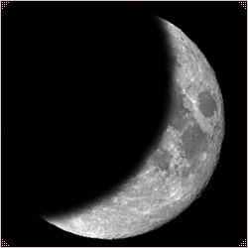
Section 2: The Moon
Phases of the Moon
Waxing Phase:
  Following a New Moon, means more of the illuminated half of the Moon can be seen each night and the Moon gets bigger.

Slide 14
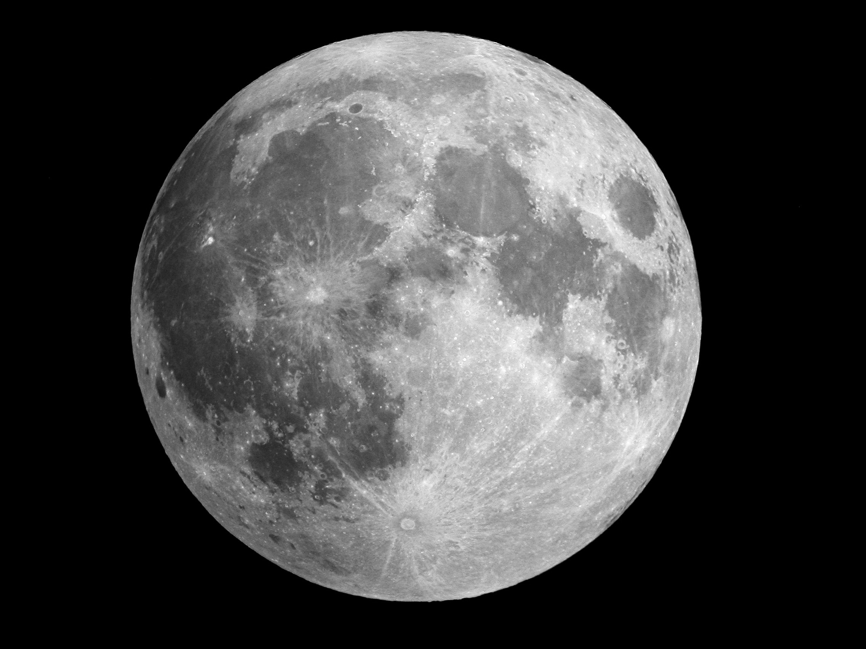
Section 2: The Moon
Phases of the Moon
Full Moon:
  When the lighted side of the Moon faces the Earth.

Slide 15
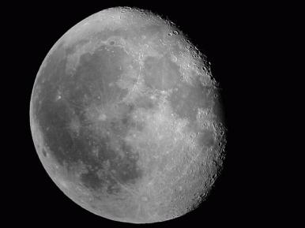
Section 2: The Moon
Phases of the Moon
Waning Phase:
  Following a Full Moon, means you see less of the illuminated half of the Moon each night and the Moon gets smaller.

Slide 16
Section 2: The Moon
Eclipses
Eclipse:
  Temporarily blocking the Sun
  The ultimate cause of all eclipses is the revolution of the Moon.
  Eclipses occur when the Moon or the Earth blocks the Sun from reaching the each other.
  They can only occur when the Moon, Earth and the Sun are all lined up.

Slide 17
Section 2: The Moon
Eclipses
Solar Eclipse:
  When the Moon moves directly between the Earth and the Sun and casts a shadow over part of the Earth.
  The amount of shadow depends on where you are on the Earth.

Slide 18
Section 2: The Moon
Eclipses
Solar Eclipse:
  The darkest portion of the Solar Eclipse is when you are in the umbra, which is the darkest part of the shadow.
  The lighter part of the shadow is called the penumbra. This is because some light gets through.

Slide 19
Section 2: The Moon
Eclipses
Lunar Eclipse:
  When the Earth’s shadow falls on the Moon.
  The Earth is between the Moon and the Sun.
  The total Lunar Eclipse is because the Moon is totally in the Earth’s umbra.

Slide 20
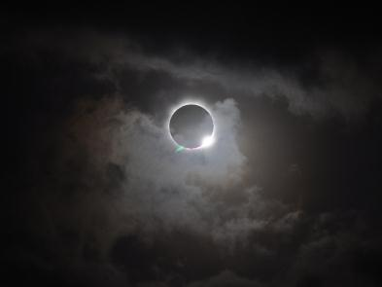
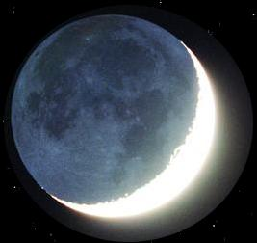
Section 2: The Moon
Eclipses
Solar
Lunar

Slide 21
Section 2: The Moon
More Vocabulary
Maria: the resulting dark, flat regions of the moon.
Impact basin: the depression left behind by an object striking the Moon.

Slide 22
Section 1: The Solar System
The Solar System
The Solar System:
  It is made up of eight planets, including Mercury, Venus, Earth, Mars, Jupiter, Saturn, Uranus and Neptune.
  All planets orbit the Sun.
  Inner Planets = Mercury, Venus, Earth, Mars
  Outer Planets = Jupiter, Saturn, Uranus, Neptune
  The largest planet in our Solar System is Jupiter.

Slide 23
Section 1: The Solar System
The Solar System
Other objects in our Solar System:
  Comets = made up of dust, rock particles, and frozen water
    They break up and get smaller the closer and the more times they pass by the Sun.
  Meteoroids = the smaller pieces that are left as the comet breaks apart.

Slide 24
Section 1: The Solar System
The Solar System
Other objects in our Solar System:
  Meteor = a meteoroid that burns up in the Earth’s atmosphere
  Asteroid = a piece of rock that is similar to that which formed the planets
    Mostly asteroids are located in an area between the orbits of Mars and Jupiter, called the asteroid belt.

Slide 25
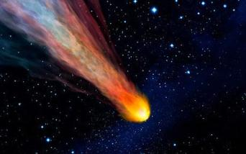
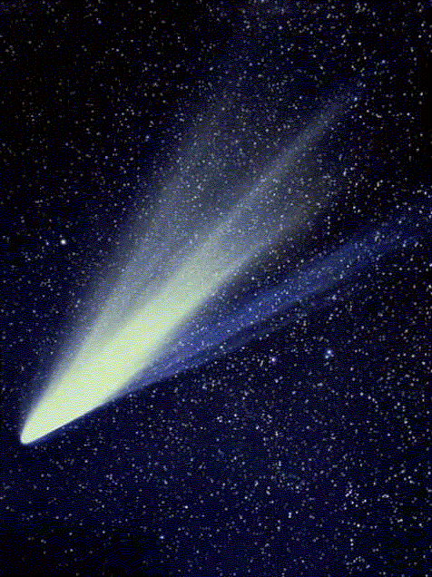
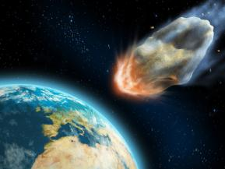
Section 1: The Solar System
The Solar System
Meteorite
Comet
Asteroid

Slide 26
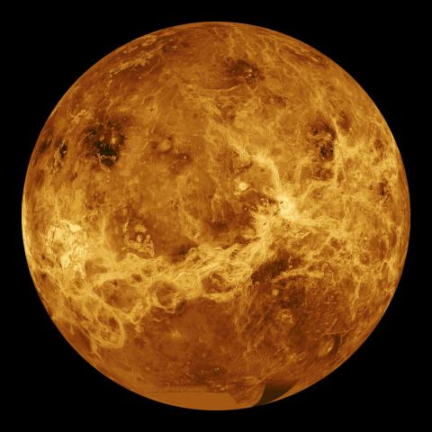
Mercury
Closest to the Sun
Second-smallest planet
Surface: craters and high cliffs
No atmosphere
Temperature: 425 C to -170 C
No moons

Slide 27
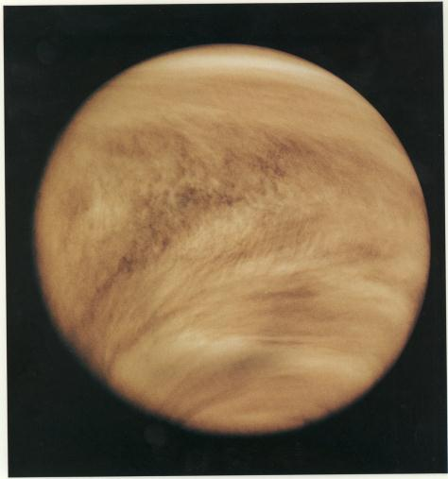
Venus
Similar to Earth in size and mass
Thick atmosphere made of carbon dioxide
Droplets of sulfuric acid in atmosphere gives clouds yellowish color
Surface: craters, cracks, and volcanoes
Temperature: 450 C to 475 C
No moons

Slide 28
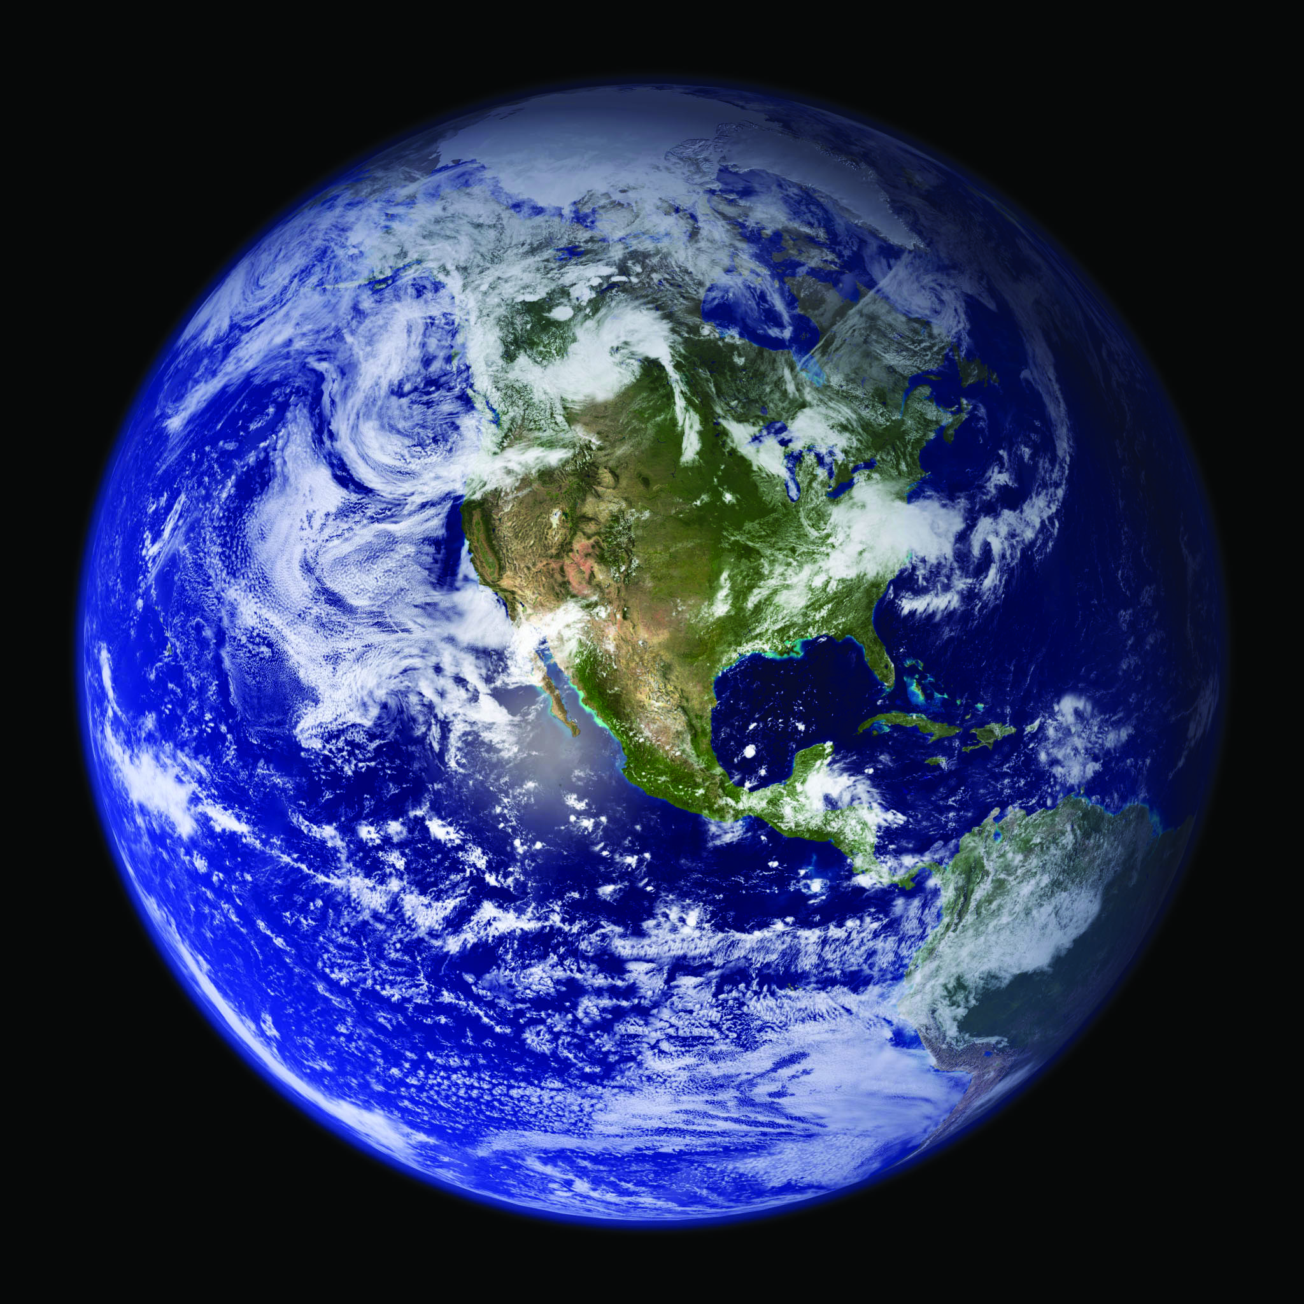
Earth
Atmosphere protects life
Surface: temperatures allow water to exist as solid, liquid, and gas
Only planet where life is known to exist
Has one large moon

Slide 29
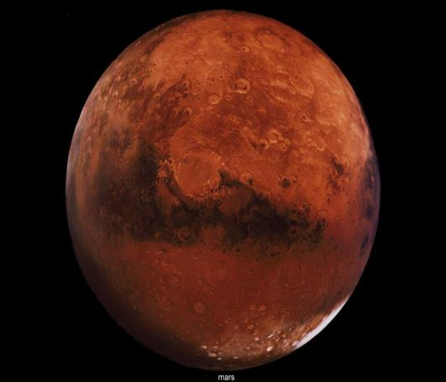
Mars
Ice caps made of frozen carbon dioxide and water
Thin atmosphere made of mostly carbon dioxide
Iron oxide in soil causes reddish-yellow appearance
Surface: channels indicate water flow and has large volcanoes and valleys
Temperature: -125C to 35C
Huge dust storms often blanket the planet
Has two small moon

Slide 30
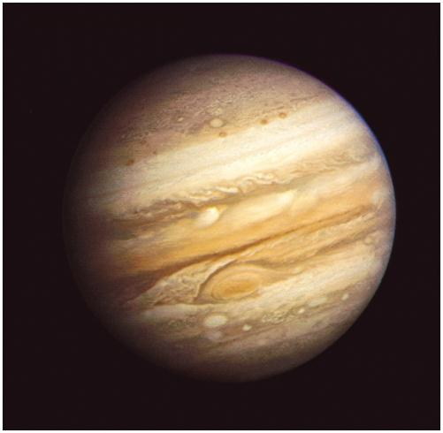
Jupiter
Largest planet
Has faint rings
Atmosphere: mostly hydrogen and helium; continuous storms swirl on the planet – the largest is The Great Red Spot
Has four large moons and 59 small moons

Slide 31
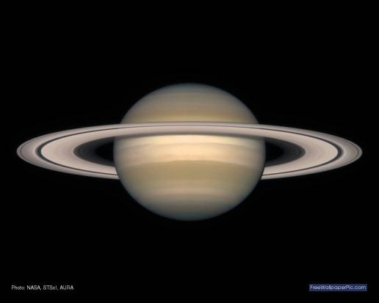
Saturn
Second-largest planet
Has a complex ring
Atmosphere: thick and is mostly hydrogen and helium
Has at least 47 moons

Slide 32
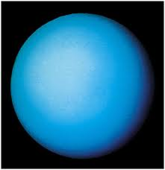
Uranus
Large, gaseous planet with thin rings
Atmosphere: hydrogen, helium, and methane
Axis of rotation is nearly parallel to plane of orbit
Has 27 moons

Slide 33
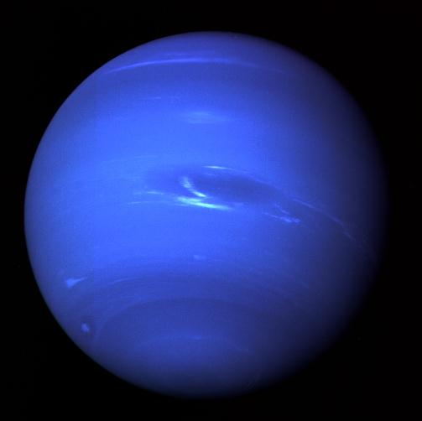
Neptune
Large, gaseous planet with rings
Farther from the Sun than Pluto
Methane atmosphere causes its bluish-green color
Has dark-colored storms
Has 13 moons

