Slide 1
Chapter three
Atoms and Elements

Slide 2
Section 1: Structure of Matter
What Makes Up Matter?
Matter is anything that has mass and takes up space.
Early Philosophers:
  Earth
  Water
  Air
  Fire

Slide 3
Section 1: Structure of Matter
What Makes Up Matter?
Greek philosopher, Democritus:
  the universe was made of empty space
  tiny bits of stuff that were so small they could no longer be divided into smaller pieces

Slide 4
Section 1: Structure of Matter
What Makes Up Matter?
The term atom comes from a Greek word that means “cannot be divided”
Today an atom is defined as a small particle that makes up most types of matter.

Slide 5
Section 1: Structure of Matter
What Makes Up Matter?
French chemist, Lavoisier:
  Showed that matter does not disappear when burned or rusted
  Work led to the law of conservation of matter, which states that matter is not created or destroyed – it only changes form.

Slide 6
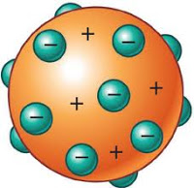
Section 1: Structure of Matter
Model of the Atom
J. J. Thomson (early 1900s)
  Used a cathode ray tube which lead to the discovery of electrons.
Electrons are the negatively charged particles of an atom.

Slide 7
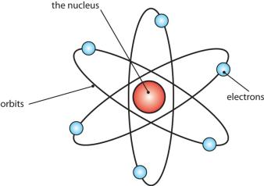
Section 1: Structure of Matter
Model of the Atom
Ernest Rutherford (1910)
  Used a thin piece of gold foil with alpha particles
  Most of the particles passed straight through the foil while some changed direction or bounced back
  Concluded that because so many passed through, atoms must be made of mostly empty space

Slide 8
Section 1: Structure of Matter
Model of the Atom
Ernest Rutherford (1910)
  He called the positively charged, central part of the atom the nucleus.
  He named the positively charged particles in the nucleus protons.

Slide 9
Section 1: Structure of Matter
Model of the Atom
James Chadwick
  Was a student of Rutherford
  Experimented with new particles and found that they were not affected by an electric field
  He called these uncharged particles neutrons

Slide 10
Section 1: Structure of Matter
Model of the Atom
Niels Bohr (early 20th century)
  Found that electrons arrange according to energy levels
  Higher energy levels are farther away from the nucleus
  By the 1930s, it was recognized that matter was made up of atoms, which are made up of protons, neutrons, and electrons.

Slide 11
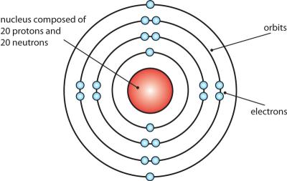
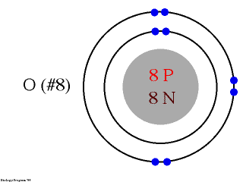
Section 1: Structure of Matter
Model of the Atom

Slide 12
Section 2: The Simplest Matter
The Elements
An element is matter made of only one kind of atom.
At least 110 elements are known and at least 90 of them occur naturally on Earth.
Types of elements
  Naturally occurring (ex. Oxygen and nitrogen)
  Synthetic (made by scientists)

Slide 13
Section 2: The Simplest Matter
Periodic Table
Periodic Table of Elements:
  Created by Chemists to organize and display the elements
  Each element is represented by a chemical symbol containing letters
  Elements are organized by their properties in rows and columns
    Rows = periods
    Columns = groups (family)

Slide 14
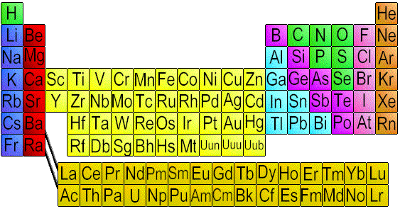
Section 2: The Simplest Matter
Periodic Table

Slide 15
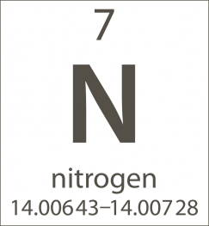
Section 2: The Simplest Matter
Identifying Characteristics
Atomic number = the top number, which tells you the number of protons in the nucleus of each atom
Atoms of the same element that have different numbers of neutrons are called isotopes.

Slide 16
Section 2: The Simplest Matter
Identifying Characteristics
An atom’s mass number is the number of protons plus the number of neutrons it contains.
The atomic mass is the weighted average mass of the isotopes of an element and it can be found below the element symbol.

Slide 17
Section 2: The Simplest Matter
Classification of Elements
Classification of Elements
  3 categories of Elements
    Metals
    Metalloids
    Non-metals

Slide 18
Section 2: The Simplest Matter
Classification of Elements
Metals
  Shiny or metallic in appearance
  Good conductors of heat and electricity
  Solids at room temperature
  Malleable = can be bent into various sizes

Slide 19
Section 2: The Simplest Matter
Classification of Elements
Non-metals
  Usually dull in appearance
  Poor conductors of heat and electricity
  Gases at room temperature
  Generally brittle and cannot change shape without breaking
  Essential to the chemicals of life

Slide 20
Section 2: The Simplest Matter
Classification of Elements
Metalloids
  Have characteristics of both metals and non-metals
  Solids at room temperature
  Some are shiny and most are conductors

Slide 21
Section 3: Compounds and Mixtures
Substances
Matter that has the same composition and properties throughout is called a substance.
A compound is a substance whose smallest unit is made up of atoms of more than one element bonded together.
When two or more substances (elements or compounds) come together but don’t combine to make a new substance, a mixture is created.

