Slide 1
Chapter 3
MINERALS

Slide 2
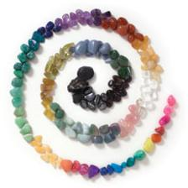
Section 1: Minerals
What is a Mineral?
A ­mineral is a naturally occurring, inorganic solid with a definite chemical composition and an orderly arrangement of atoms.
About 4,000 different minerals are found on Earth.

Slide 3
Section 1: Minerals
What is a Mineral?
All minerals share 4 characteristics
  Formed by natural processes
  Inorganic
  An element or compound with a definite chemical composition
  Crystalline solids
The word crystalline means that atoms are arranged in a pattern that is repeated over and over again.

Slide 4
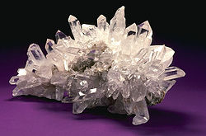
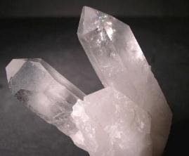
Section 1: Minerals
The Structure of Minerals
A crystal is a solid in which the atoms are arranged in orderly, repeating patterns.
Crystals form by many processes; some from magma, some from solutions of salt.

Slide 5
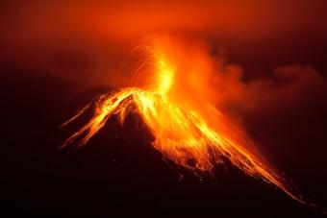
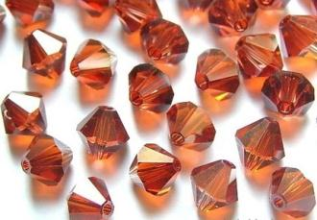
Section 1: Minerals
The Structure of Minerals
Crystal from magma
  Magma, hot melted rock material, cools when it reaches Earth’s surface.
  As the magma cools, its atoms lose heat energy, move closer together, and begin to combine into compounds.

Slide 6
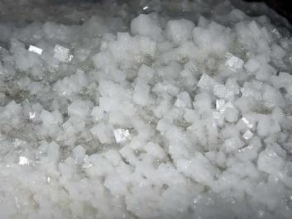
Section 1: Minerals
The Structure of Minerals
Crystal from solution
  Crystals can also form from minerals dissolved in water. When water evaporates, as in a dry climate, ions that are left behind can come together to form crystals.

Slide 7
Section 1: Minerals
Mineral Compositions and Groups
90 elements occur naturally in Earth’s crust and approximately 98% of the crust is made of only 8 of these elements.
  Oxygen
  Silicon
  Aluminum
  Iron
  Calcium
  Sodium
  Potassium
  Magnesium

Slide 8
Section 1: Minerals
Mineral Compositions and Groups
        Silicates are minerals that contain silicon and oxygen and usually one or more other elements.

Slide 9
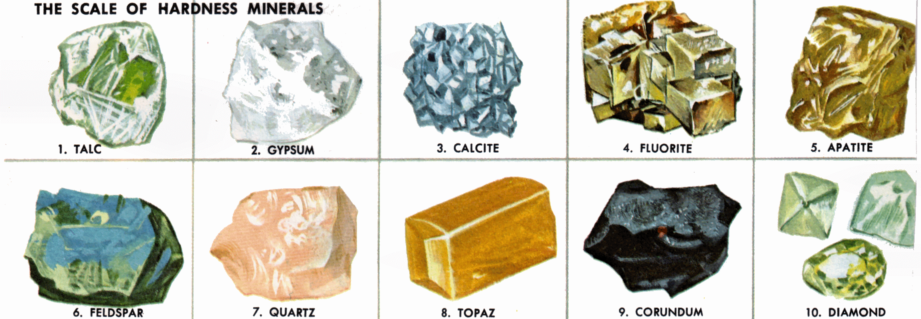
Section 2: Mineral Identification
Physical Properties
A measure of how easily a mineral can be scratched is its hardness.

Slide 10
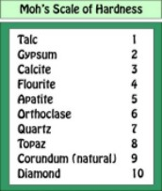
Section 2: Mineral Identification
Physical Properties
In 1824, scientist Friedrich Mohs developed a list of common minerals to compare their hardness.
Talc, the softest mineral, has a hardness value of one, and diamond, the hardest mineral, has a value of ten.

Slide 11
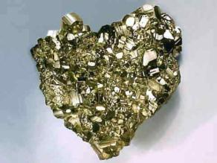
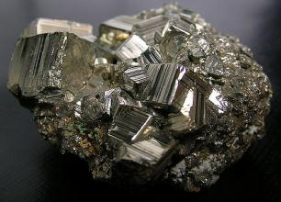
Section 2: Mineral Identification
Physical Properties
The way a mineral reflects light is known as luster.
Luster can be metallic or non-metallic

Slide 12
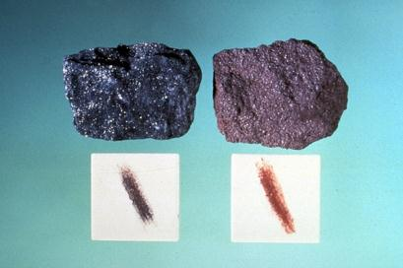
Section 2: Mineral Identification
Physical Properties
The specific gravity of a mineral is the ratio of its weight compared with the weight of an equal volume of water.
Streak is the color of a mineral when it is in a powered form.

Slide 13
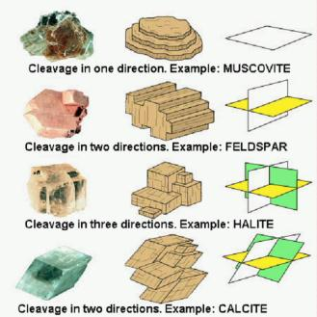
Section 2: Mineral Identification
Physical Properties
Minerals that break along smooth, flat surfaces have cleavage.
Cleavage, like hardness, is determined partly by the arrangement of the mineral’s atoms.
Minerals that break with uneven, rough, or jagged surfaces have fracture.

Slide 14
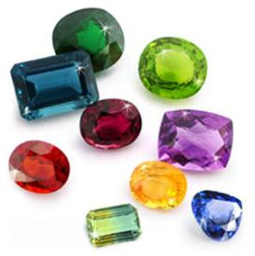
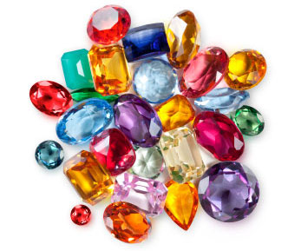
Section 3: Uses of Minerals
Gems
Gems or gemstones are highly prized, beautiful minerals that can be worn in jewelry.

Slide 15
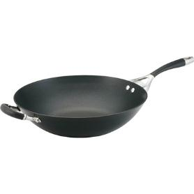
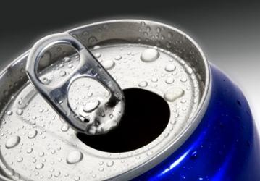
Section 3: Uses of Minerals
Useful Elements in Minerals
A mineral or rock is an ore if it contains a useful substance that can be mined at a profit.
  Another example of ore: Aluminum

