Slide 1
Chapter Four
States of Matter

Slide 2
Section 1: Matter
What is Matter?
Matter is anything that has mass and takes up space.
Matter:
  Tiny particles such as atoms, molecules, and ions
  Particles are constantly moving and attract other particles
  Motion of the particles and strength of attraction determines the state of matter.

Slide 3
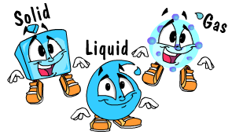
Section 1: Matter
What is Matter?
3 states of matter:
  Solid
  Liquid
  Gas

Slide 4
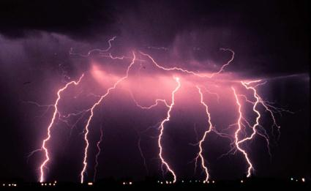
Section 1: Matter
What is Matter?
4th state: Plasma occurs at extremely high temperatures.
  Stars
  Lightning
  Neon lights

Slide 5
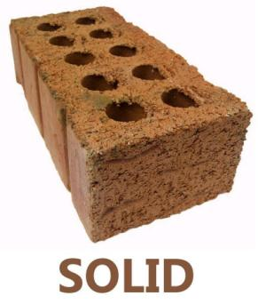
Section 1: Matter
Solids
A solid is matter with a definite shape and volume.
Solid
  Particles are tightly packed together
  Particles are vibrating in place; do not have the energy to move
  Maintain a constant shape and volume.

Slide 6
Section 1: Matter
Solids
2 types of solids:
  Crystalline
    Arranged in repeating 3-dimensional patterns
  Amorphous
    Arranged randomly (ex. Rubber, plastic, glass)

Slide 7
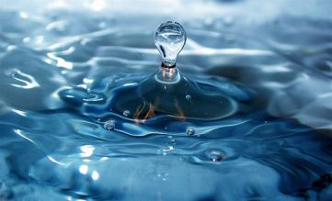
Section 1: Matter
Liquid
A liquid is matter that has a definite volume but no definite shape.
Liquid
  Particles move more freely than solids
  Change shape but maintain the same volume

Slide 8
Section 1: Matter
Liquid
A liquid’s resistance to flow is known as the liquid’s viscosity.
Viscosity results from the strength of the attraction between the particles of the liquid.
  Honey = high viscosity
  Water = low viscosity
  Viscosity increases as liquids get colder

Slide 9
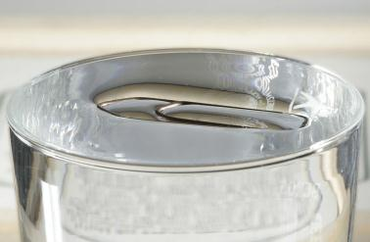
Section 1: Matter
Liquid
The uneven forces acting on the particles on the surface of a liquid are called surface tension.
Surface tension causes the liquid to act as if a thin film were stretched across its surface.

Slide 10
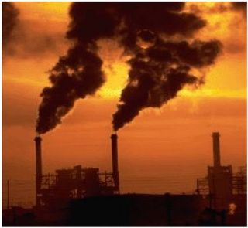
Section 1: Matter
Gas
Gas is matter that does not have a definite shape or volume.
Gas
  Particles are much farther apart
  Particles move at high speeds in all directions
  Can be expanded or compressed

Slide 11
Section 1: Matter
Gas
Matter that exists in the gas state but it is generally a liquid or solid at room temperature is called vapor. (ex. Water vapor)

Slide 12
Section 2: Changes of State
Thermal Energy and Heat
Energy
  The ability to do work or cause change
  Energy of motion = kinetic energy
  Particles within matter are in constant motion

Slide 13
Section 2: Changes of State
Thermal Energy and Heat
The total kinetic and potential energy of all the particles in a sample of matter is called thermal energy.
Thermal energy
  Extensive property that depends on the number of particles in a substance and the amount of energy each particle has
  The warmer a substance the greater the thermal energy

Slide 14
Section 2: Changes of State
Thermal Energy and Heat
Temperature
  The average kinetic energy of the individual particles is the temperature.
  Intensive property of a substance
  Different than thermal energy because thermal energy is the total and temperature is an average.

Slide 15
Section 2: Changes of State
Thermal Energy and Heat
Heat
  The movement of thermal energy from a substance at a higher temperature to one at a lower temperature.
  When substance is heated
    It gains thermal energy
    Temperature rises

Slide 16
Section 2: Changes of State
Specific Heat
Specific Heat
  The amount of heat required to raise the temperature of 1g of a substance
    Low specific heat = solids (ex. Rocks)
    High specific heat = liquids (ex. Water)

Slide 17
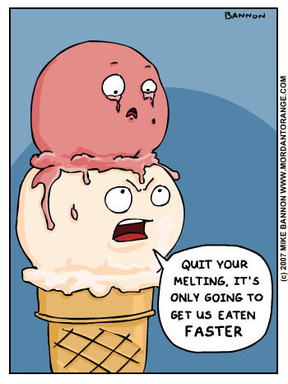
Section 2: Changes of State
Changes between Solid and Liquid States
Change of state = the change of state of matter when thermal energy is absorbed or released.
Melting
  The change from the solid state to the liquid state.
  Melting point = the temperature at which a substance changes from a solid to a liquid.

Slide 18
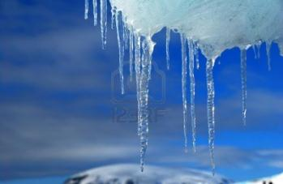
Section 2: Changes of State
Changes between Solid and Liquid States
Freezing
  The change from liquid state to the solid state.
  Freezing point = the temperature at which a substance changes from the liquid state to the solid state.

Slide 19
Section 2: Changes of State
Changes between Liquid and Gas States
Vaporization
  The change from a liquid to a gas
  Substance absorbs thermal energy
  Particles are moving very fast
  Two forms of vaporization
    Boiling = takes place under the liquid (boiling point)
    Evaporation = takes place above the liquid

Slide 20
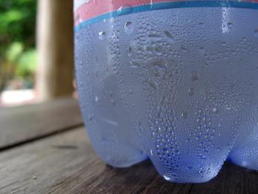
Section 2: Changes of State
Changes between Liquid and Gas States
Condensation
  Temperature does not change
  Decrease of energy changes the arrangement of particles
  Gas condenses to liquid

Slide 21
Section 2: Changes of State
Changes between Solid and Gas States
Any ideas?!?!?

Slide 22
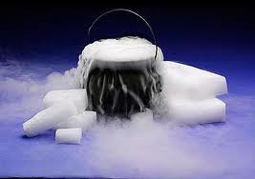
Section 2: Changes of State
Changes between Solid and Gas States

