Slide 1
Chapter four Sec #3

Slide 2
Section 3: Behavior of Fluids
Pressure
Pressure:
  Amount of force applied per unit area
  Pressure = force/area
  Unit of pressure = Pa (Pascal)

Slide 3
Section 3: Behavior of Fluids
Float or Sink
Buoyant force:
  Difference in pressure results in an upward force on an object immersed in a fluid
  Buoyant force is equal to the weight of the object = the object will float
  Buoyant force is less than the weight of the object = the object will sink

Slide 4
Section 3: Behavior of Fluids
Float or Sink
Archimedes’ principle:
  The buoyant force of an object is equal to the weight of the fluid displaced by the object
  Example:
    If you take a beaker filled with water and place object in beaker, some water will spill out.
    The weight of the spilled water = buoyant force of object

Slide 5
Section 3: Behavior of Fluids
Float or Sink
Density:
  Mass divided by volume (D= mass/volume)
  Density of water = 1
    Object higher than 1 - SINK
    Object lower than 1 - FLOAT

Slide 6
Section 3: Behavior of Fluids
Pascal’s Principle
Pascal’s principle:
  Pressure applied at any point to a confined fluid is transmitted throughout the fluid
  Example: squeeze container and the fluid will find the exit
    IE – toothpaste, water bottle, mustard, etc.

Slide 7
Chapter Six
Chemical Bonds

Slide 8
Section 1: Why Do Atoms Combine?
Atomic Structure
Review:
  Nucleus?
  3 main parts of an atom?
  How do you know the number of electrons in each atom?

Slide 9
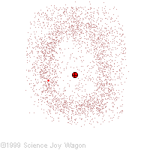
Section 1: Why Do Atoms Combine?
Electron Arrangement
Electrons
  Located in the electron cloud = an area of space around the nucleus
  Made up of different energy levels
    The closer they are to the nucleus = the stronger the attractive force
    The farther from the nucleus = the higher the energy level

Slide 10
Section 1: Why Do Atoms Combine?
Electron Arrangement
Electrons
  More electrons as you get farther out
  Each level can only hold a certain number of electrons
  First Five levels = 2, 8, 18, 32, 50
  Electrons don’t go to the next level until the previous level is filled
    IE – 10 electrons would fill the first two levels

Slide 11
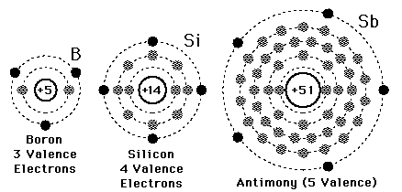
Section 1: Why Do Atoms Combine?
Electron Configuration
Valence electrons:
  Electrons in the outer energy level
  Help determine characteristics of atoms
  Determine how easily, or if an atom will bond with another atom

Slide 12
Section 1: Why Do Atoms Combine?
Electron Configuration
Atoms with similar valence electron numbers have some similar characteristics.
Columns on Periodic Table = same valence number
Atoms are more stable when energy levels are full

Slide 13
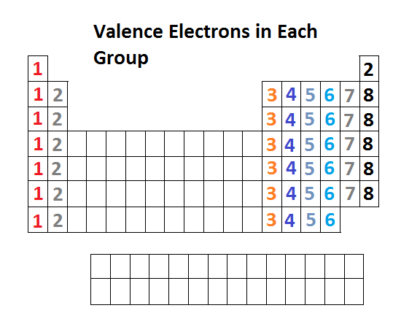
Section 1: Why Do Atoms Combine?
Electron Configuration

Slide 14


Section 1: Why Do Atoms Combine?
Electron Dot Diagram
Electron Dot Diagrams:
  Short way of showing valence electrons for an element.
  Chemical symbol in center with dots around it showing the number of valence electrons.
  The number of dots is shown by the group number the element is in.

Slide 15
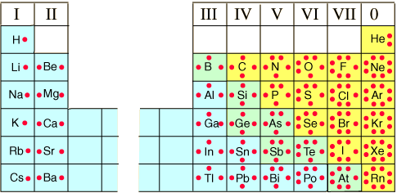
Section 1: Why Do Atoms Combine?
Electron Dot Diagram

Slide 16
Section 2: How Elements Bond
Ionic Bonds
Chemical Bond:
  A force that holds two atoms together
Two Main Types of Bonds:
  1) Ionic Bond
  2) Covalent Bond

Slide 17
Section 2: How Elements Bond
Ionic Bonds
Ionic Bond
  The transfer of electrons, either losing or gaining
  Example: Na (Sodium) = 11 electrons
    Loses one electron = 10
  Cl (Chlorine) = 17 electrons
    Gains one electron = 18

Slide 18
Section 2: How Elements Bond
Ionic Bonds
Na is now the same as Neon (10) and Cl is the same as Argon (18) but are they Neon and Argon?
No.
Because the Protons stay the same!

Slide 19
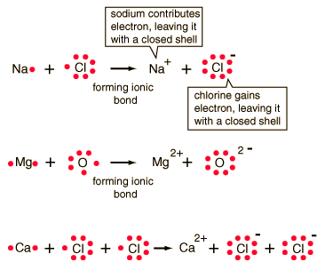
Section 2: How Elements Bond
Ionic Bonds
Ion:
  Atom with a charge
  Positive ion = losing an electron giving the atom a positive charge
  Negative ion = gaining an electron giving the atom a negative charge

Slide 20
Section 2: How Elements Bond
Ionic Bonds
This attraction is a chemical bond called an ionic bond.
Compound = pure substance that contains two or more elements
Sodium Chloride (Na + Cl) = table salt

Slide 21
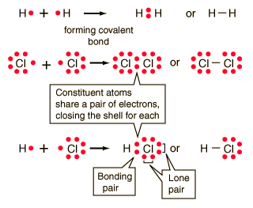
Section 2: How Elements Bond
Covalent Bonds
Covalent Bond
  The sharing of electrons between outer energy levels
  They form a neutral particle = molecule.

Slide 22
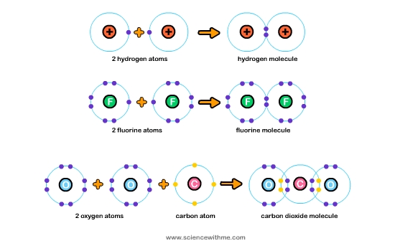
Section 2: How Elements Bond
Covalent Bonds

Slide 23
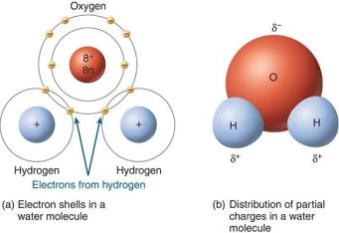
Section 2: How Elements Bond
Polar and Non-polar Molecules
Do atoms always share electrons equally?
  No they do not. Example: H₂0:
    Oxygen attracts the electrons more than Hydrogen.
    This causes the oxygen end of the molecule to have a slight negative charge, and the hydrogen end to have a slight positive charge.

Slide 24
Section 2: How Elements Bond
Polar and Non-polar Molecules
Polar Molecule:
  When atoms do not share electrons equally, resulting in a charged particle.
Non-polar Molecule:
  Bonds are between atoms of the same element.

Slide 25
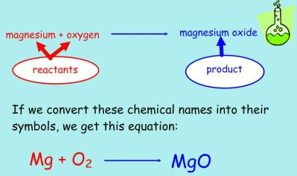
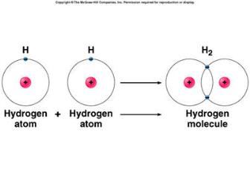
Section 2: How Elements Bond
Chemical Shorthand
Chemical Shorthand:
  Why use symbols for elements?
  Easier and shorter way to write elements and chemical formulas
2

Slide 26
Section 2: How Elements Bond
Chemical Shorthand
Chemical Formulas
  Combination of chemical symbols of the elements that tells what elements are present in a molecule, and how many atoms of each element are present.
  Allows scientists to communicate and share research
  Example, CO₂ = carbon dioxide
    “2” = subscript (“Sub” = below, “script” = write)
    Therefore, “2” means two oxygen atoms
    If there is no number = 1 atom of that element

