Slide 1
Chapter SeveN
Weathering

Slide 2
Section 1: Weathering
Weathering and Its Effect
Surface processes that work to break down rock are called weathering.
Weathering breaks rock into smaller and smaller pieces, such as sand, silt, and clay.

Slide 3
Section 1: Weathering
Weathering and Its Effect
Soil texture influences virtually all mechanical and chemical processes in the soil, including the ability to hold moisture and nutrients.
There are two kinds of weathering:
  Mechanical weathering
  Chemical weathering

Slide 4
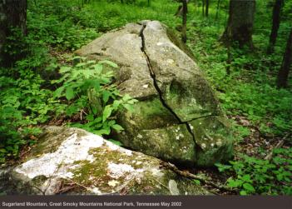
Section 1: Weathering
Mechanical Weathering
Mechanical weathering occurs when rocks are broken apart by physical processes.
Growing plants, burrowing animals, and expanding ice are some of the things that can mechanically weather rocks.

Slide 5
Section 1: Weathering
Mechanical Weathering
Water and nutrients that collect in the cracks of rocks result in conditions in which plants can grow. As the roots grow, they enlarge the cracks.
Burrowing animals also cause mechanical weathering by loosening sediments and pushing it to the surface.

Slide 6
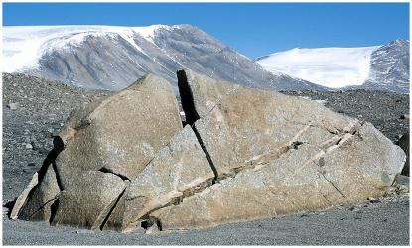
Section 1: Weathering
Mechanical Weathering
Ice wedging occurs in temperate and cold climates where water enters cracks in rocks and freezes.
Because water expands when it turns to ice, pressure builds up in the cracks and it breaks apart the rocks.

Slide 7
Section 1: Weathering
Chemical Weathering
The second type of weathering, chemical weathering, occurs when chemical reactions dissolve or alter the minerals in rocks or change them into different minerals.
This occurs mostly at or near the Earth’s surface.
  Natural Acids
  Plant Acids
  Oxidation occurs when some materials are exposed to oxygen and water.

Slide 8
Section 1: Weathering
Effects of Climate
Climate is the pattern of weather that occurs in a particular area over many years.
  Cold climates = mechanical weathering (ex. ice wedging)
  Warmer climates = chemical weathering

Slide 9
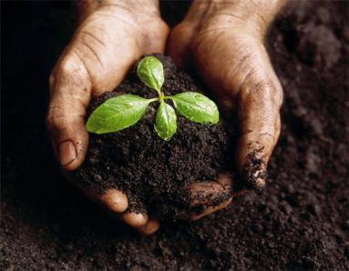
Section 2: The Nature of Soil
Formation of Soil
Soil is a mixture of weathered rock, decayed organic matter, mineral fragments, water, and air.
Climate, slope, types of rock, types of vegetation, and length of time that rock has been weathering all affect the formation of soil.

Slide 10
Section 2: The Nature of Soil
Composition of Soil
Most organic matter in soil comes from plants.
After plant and animal materials gets into soil, fungi and bacteria cause it to decay.
The decayed organic matter turns into a dark-colored material called humus, which serves as a source of nutrients for plants.

Slide 11
Section 2: The Nature of Soil
Soil Profile
Horizons = the different layers of soil which form a soil profile.
Horizon A
  The top layer of soil
  Litter might cover the top which consists of leaves, twigs, and other organic material that can be changed to humus.
  Litter helps prevent erosion and evaporation of water from soil.
  Typically the darkest soil layer.

Slide 12
Section 2: The Nature of Soil
Soil Profile
Horizon B
  Also known as sub soil and lighter in color.
  Leaching is the removal of minerals that have been dissolved in water.
Horizon C
  Consists of partially weathered rock and is the bottom horizon in a soil profile.
  Does not contain much organic matter
  Lightest in color

Slide 13
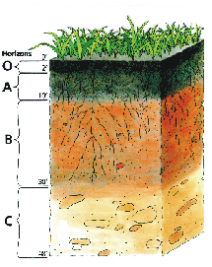
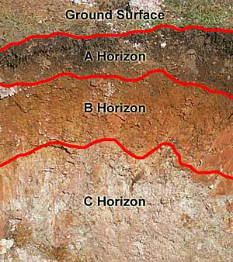
Section 2: The Nature of Soil
Soil Profile

Slide 14
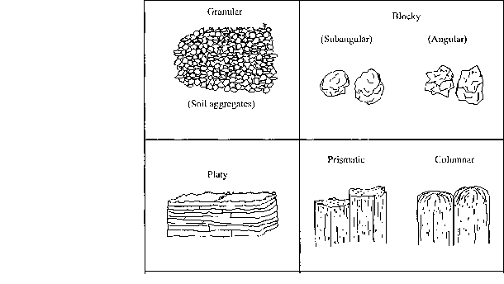
Section 2: The Nature of Soil
Soil Profile
There are 4 classes of soil structure
  Granular
  Platy
  Blocky
  Prismatic

Slide 15
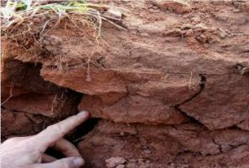
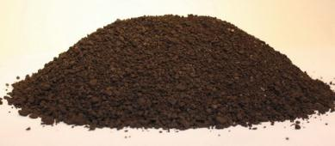
Section 2: The Nature of Soil
Soil Profile
Granular: common in surface soils with high organic content glues minerals together.
Platy: found in subsurface soils that have been leached or compacted by animals or machinery.

Slide 16
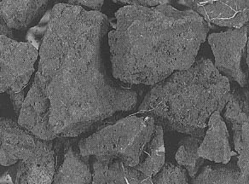
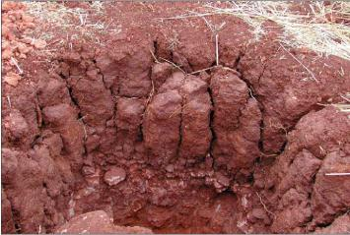
Section 2: The Nature of Soil
Soil Profile
Blocky: common in sub soil or surface soils with high clay content, which shrinks and swells, producing cracks.
Prismatic: found in B horizons and are very dense and difficult for plant roots to penetrate.

Slide 17
Section 3: Soil Erosion
Causes and Effects of Soil Erosion
Soil erodes when it is moved from the place where it formed.
Erosion can be caused by:
  Water
  Wind
  Agricultural Cultivation
  Forest Harvesting
  Overgrazing

Slide 18
Section 3: Soil Erosion
Preventing Soil Erosion
People can do several things to prevent erosion and conserve soil.
  Plant belts of trees to break the force of wind
  Grazing management
Using no-till farming where plant stalks are left in the field after harvesting and the next year’s crop is planted within the stalks without plowing.

Slide 19
Section 3: Soil Erosion
Preventing Soil Erosion
On gentle slopes, planting along the natural contours of the land is called contour farming.
Terracing is a method in which steep-sided, level topped areas are built onto the sides of the steep hills and mountains so that crops can be grown.

Slide 20
Chapter Eight
Erosion

Slide 21
Section 1: Erosion by Gravity
Erosion and Deposition
Erosion is a process that wears away surface materials and moves them from one place to another.
Types of erosion
  Gravity
  Glaciers
  Water
  Wind

Slide 22
Section 1: Erosion by Gravity
Erosion and Deposition
Gravity is the force of attraction that pulls all objects toward Earth’s center.
Water and wind erode materials only when they have enough energy of motion to do work.

Slide 23
Section 1: Erosion by Gravity
Erosion and Deposition
Glacial erosion works differently by slowly moving sediment that is trapped in solid ice.
Agents of erosion drop the sediments they are carrying as they lose energy and this is called deposition.

Slide 24
Section 1: Erosion by Gravity
Mass Movement
  A mass movement is any type of erosion that happens as gravity moves materials downslope.
  Common types of mass movement include slump, creep, rock falls, rockslides, and mud flows.

Slide 25
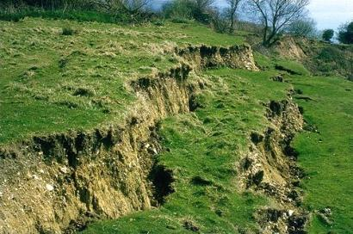
Section 1: Erosion by Gravity
Mass Movement
When a mass of material slips down along a curved surface, the mass movement is called slump.
When a slope becomes too steep, the base material no longer can support the rock and sediment above it and the rock and soil slip downslope.

Slide 26
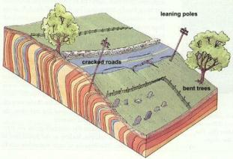
Section 1: Erosion by Gravity
Mass Movement
Creep occurs when sediments slowly shift their positions downhill.
Rock falls happen when blocks of rock break loose from a steep slope and tumble through the air.

Slide 27
Section 1: Erosion by Gravity
Mass Movement
  Rockslides occur when layers of rock – usually steep layers – slip downslope suddenly.
  Mudflows usually occur in areas that have thick layers of loose sediments and water flowing down a slope.
  Mudflows, rock slides, rock falls, creep, and slump are similar in that they all depend on gravity to make them happen.

Slide 28
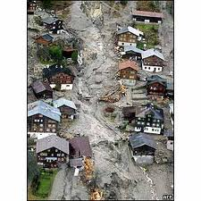
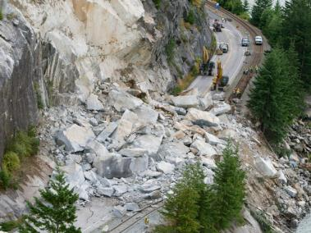
Section 1: Erosion by Gravity
Mass Movement

Slide 29
Section 2: Glaciers
Ice Eroding Rock
A large mass of ice and snow moving on land under its own weight is a glacier.
As glaciers pass over land, they erode it, changing features on the surface.
When the water refreezes, cracks expand and the rock fractures.
The ice then lifts pieces of the rock out, which is a process called plucking.
Plucked rock fragments and sand at the base scrape the soil and bedrock eroding the ground.

Slide 30
Section 2: Glaciers
Ice Depositing Sediments
When glaciers begin to melt, sediment is dropped on the land.
A mixture of boulders, sand, clay, and silt that is left behind is called till.

Slide 31
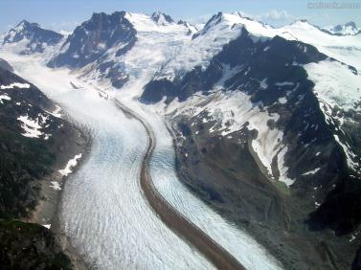
Section 2: Glaciers
Ice Depositing Sediments
Till is deposited at the end of a glacier when it is not moving forward but material that is piled up as a big ridge along the sides of the glacier’s path is called moraine.

Slide 32
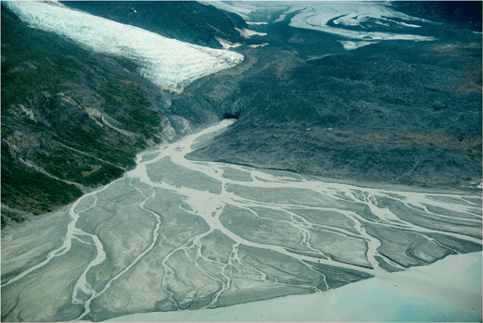
Section 2: Glaciers
Ice Depositing Sediments
Material that is deposited by the melt-water from a glacier, most often beyond the end of it is called outwash.

Slide 33
Section 2: Glaciers
Types of Glaciers
There are two different types of glaciers
  Continental
  Valley
Continental glaciers are big , thick masses that are made from ice and snow that make up about 10% of Earth.

Slide 34
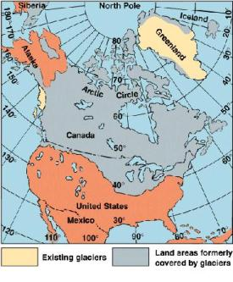
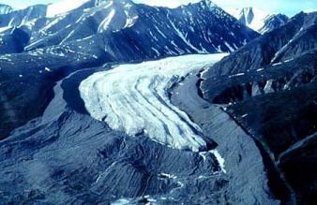
Section 2: Glaciers
Types of Glaciers
Valley glaciers are smaller glaciers that grow and creep along mountain sides and valleys.

Slide 35
Section 3: Wind
Wind Erosion
When air moves, it picks up loose material and transports it to other places.
Air is different from other erosional forces because it usually cannot pick up heavy sediments.
Wind erodes Earth’s surface in two ways
  Deflation
  Abrasion

Slide 36
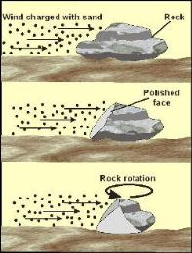
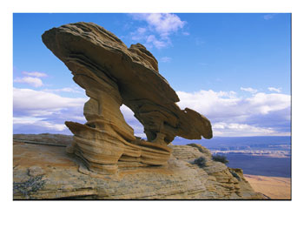
Section 3: Wind
Wind Erosion
Deflation blows across loose sediment removing small particles such as silt and sand.
When windblown sediment strikes rock, the surface of the rock gets scraped and worn away by a process called abrasion.

Slide 37
Section 3: Wind
Wind Erosion
Deflation and abrasion happen to all land surfaces but occur mostly in deserts, beaches, and plowed fields.
One of the best ways to slow or stop wind erosion is to plant vegetation.

Slide 38
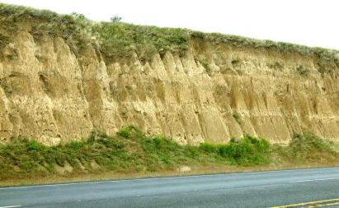
Section 3: Wind
Deposition by Wind
Over time, these wind blown deposits develop into landforms, such as dunes and loess.
Loess is windblown deposit of tightly packed, fine-grained sediments, which settle on hilltops in valleys.

Slide 39
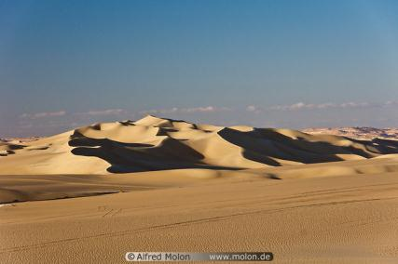
Section 3: Wind
Deposition by Wind
Dunes are mounds of sediments that are drifted by the wind and are most common in desert areas.

