Slide 1
Chapter Eight
Substances, Mixtures, and Solubility

Slide 2
Section 1: What is a Solution?
Substances
Substance:
  Matter that has the same fixed composition and properties.
    Example: Oxygen, Carbon, Nitrogen, water
  Cannot be broken down by physical process
    Example: grinding
  A chemical process is the only method to change a substance into more than one new substance.
    Example: Burning, reacting with other chemicals

Slide 3
Section 1: What is a Solution?
Substances
Compound = Atoms of two or more elements chemically combined
  Example: Water = H₂O

Slide 4
Section 1: What is a Solution?
Mixtures
Mixture = combinations of substances that can be separated by physical means
  Example: water in the ocean (salt water)
Difference between a compound and a mixture?
  Compounds always have the same proportions of different substances, and mixtures don’t

Slide 5
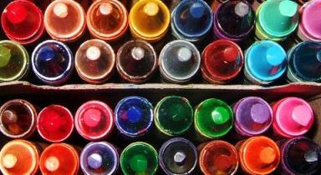
Section 1: What is a Solution?
Mixtures
Two different kinds of mixtures:
  Heterogeneous mixture: “hetero” = different
    Not mixed evenly
    Easy to tell different parts of mixture
      Examples: watermelon and concrete

Slide 6
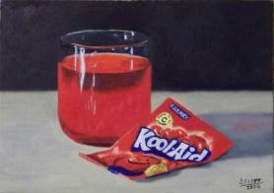
Section 1: What is a Solution?
Mixtures
Two different kinds of mixtures:
  Homogeneous mixture: “homo” = composition is the same throughout
    Usually not easy to tell parts of mixture apart
      Examples: salt water and milk
    Another name for a homogeneous mixture is a solution

Slide 7
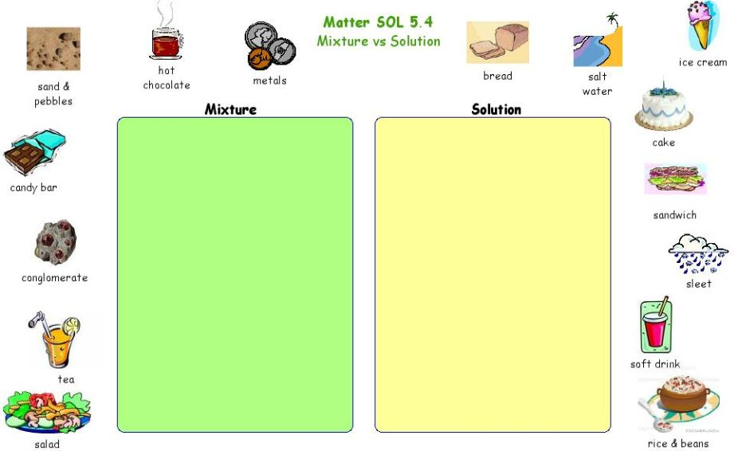

Slide 8
Section 1: What is a Solution?
Solutions
Forming Solutions = one substance disappears into the other
  Solute: substance that disappears or dissolves
  Solvent: substance that dissolves the solute
    a solution usually contains more solvent than solute
  Soluble: a substance that readily dissolves in another
  Insoluble: a substance that doesn’t readily dissolve
    Example: Salt H₂0

Slide 9
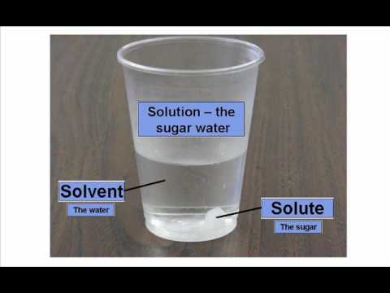
Section 1: What is a Solution?
Solutions

Slide 10
Section 1: What is a Solution?
Solutions
Precipitate = some substances can be combined (bonded) to fall out of a liquid as a solid
  Example: soap scum that forms when minerals in water react with soap

Slide 11
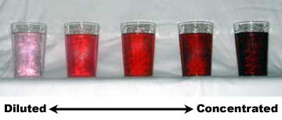
Section 1: What is a Solution?
Solutions
Concentration = how much solute is present when compared to the amount of solvent
  A concentrated solution has more solute present in a given amount of solvent.
  A dilute solution would not have as much solute in a given amount of solvent.

Slide 12
Section 1: What is a Solution?
Types of Solutions
Solutions are more than just a solid (solute) in a liquid (solvent)
Many kinds that can involve solids, liquids, and gases
All around you, and inside you!

Slide 13
Section 1: What is a Solution?
Types of Solutions
Gaseous Solutions:
  Small amount of one gas is dissolved in a larger amount of another gas
  Example: gas we breathe
    Nitrogen = 78% of air
    Others: Oxygen, CO₂ , Ar, Ne, He, Krypton, H, Xe, & O₃
      Solvent = N
      Solute = all others

Slide 14
Section 1: What is a Solution?
Types of Solutions
Liquid Solutions:
  Most familiar with = liquid solvent mixed with another liquid, solid, or gas
    Gas - Liquid solution
      Example: Soda = CO₂ , liquid
    Liquid – Liquid solution
      Example: Vinegar =95% H₂O and 5% Acetic Acid

Slide 15
Section 1: What is a Solution?
Types of Solutions
Solid Solutions:
  Solvent is a solid with a gas, liquid or solid
    Most common solid – solid solution both solvent and solute are solids 2 or more metals = alloy
    Gas – liquid
      Example: freezing can of soda

Slide 16
Section 2: Solubility
Water – The Universal Solvent
Universal solvent = H₂O
  H₂O can dissolve many different solutes
  H₂O is a polar molecule – has a slight charge on each end of the molecule – the positive and negative charges on each end pulls other molecules apart
  A solution in which water is the solvent is called an aqueous solution

Slide 17
Section 2: Solubility
Water – The Universal Solvent
Solubility = describes how much solute will dissolve in a given amount of solvent
A solution that contains all of the solute that it can hold under given conditions = saturated solution
The concentration is a solution tells you how much solute is present compared to the amount of solvent.

Slide 18
Section 3: Acidic and Basic Solutions
Acids
Acids:
  Substances that taste sour and produce positive hydrogen ions when dissolved in water and turns litmus paper red
  Reacts with some metals and will leave holes, very corrosive
    Examples: citric juice, vinegar, dill pickles, etc.

Slide 19
Section 3: Acidic and Basic Solutions
Acids
Acids can cause burns and damage body tissues
  Example: carbonic acid dissolves calcium carbonate in limestone, ants inject formic acid to cause pain, sulfuric acid is in auto batteries = battery acid, hydrochloric acid is in your stomach!

Slide 20
Section 3: Acidic and Basic Solutions
Bases
Bases:
  Substances that taste bitter and produce negative hydroxide ions when dissolved in water and turns litmus paper blue
  Very corrosive but usually won’t hurt metals
    Examples: soap

Slide 21
Section 3: Acidic and Basic Solutions
Bases
Bases can cause burns and damage body tissues
  Examples: hydroxide ions react with certain substances such as dirt and grease, so it is a good cleaning solution (Ammonia), antacid tablets, chalk, and your blood is a basic solution!

Slide 22
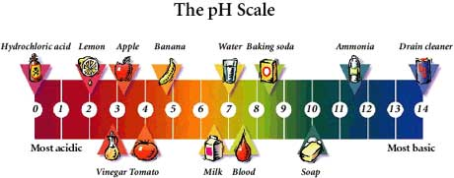
Section 3: Acidic and Basic Solutions
What is pH?
pH: measure of how acidic or basic a solution is
pH scale: measures the strength of acids and bases
  scale is from 0 to 14
  lower numbers are acidic, and higher numbers are basic
  number 7 is neutral

Slide 23
Section 3: Acidic and Basic Solutions
What is pH?
Neutralization = reaction that occurs between an acid and a base in which the properties of each one are cancelled out.
  Example: Hydrochloric acid in your stomach, too much will cause discomfort
  What do you do?
  You take an antacid and it gets rid of stomach ache
    Antacid is a base that counteracts the acid.
    A strong acid reacting with a strong base will form a salt

Slide 24
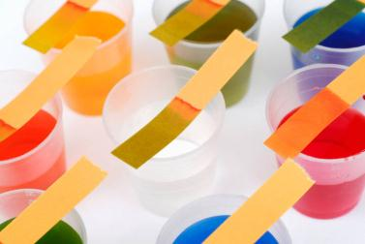
Section 3: Acidic and Basic Solutions
What is pH?
Acid & Base Indicators:
  Let’s you know if the compound is an acid or a base by the color
  Main indicator:
    litmus paper = acid turns the paper red, base turns the paper blue

